Slide 1



Viettel Digital Talent Program
Platform as a Service (PaaS)
www.viettel.com.vn

Slide 2

Session Topics
PaaS Overview
Kubernetes Overview
Kubernetes Control/Data Plane
Kubernetes Workload Management
Kubernetes Networking Model
Kubernetes Persistent Storage
Service Mesh Overview
www.viettel.com.vn

Slide 3
PaaS Overview
www.viettel.com.vn

Slide 4
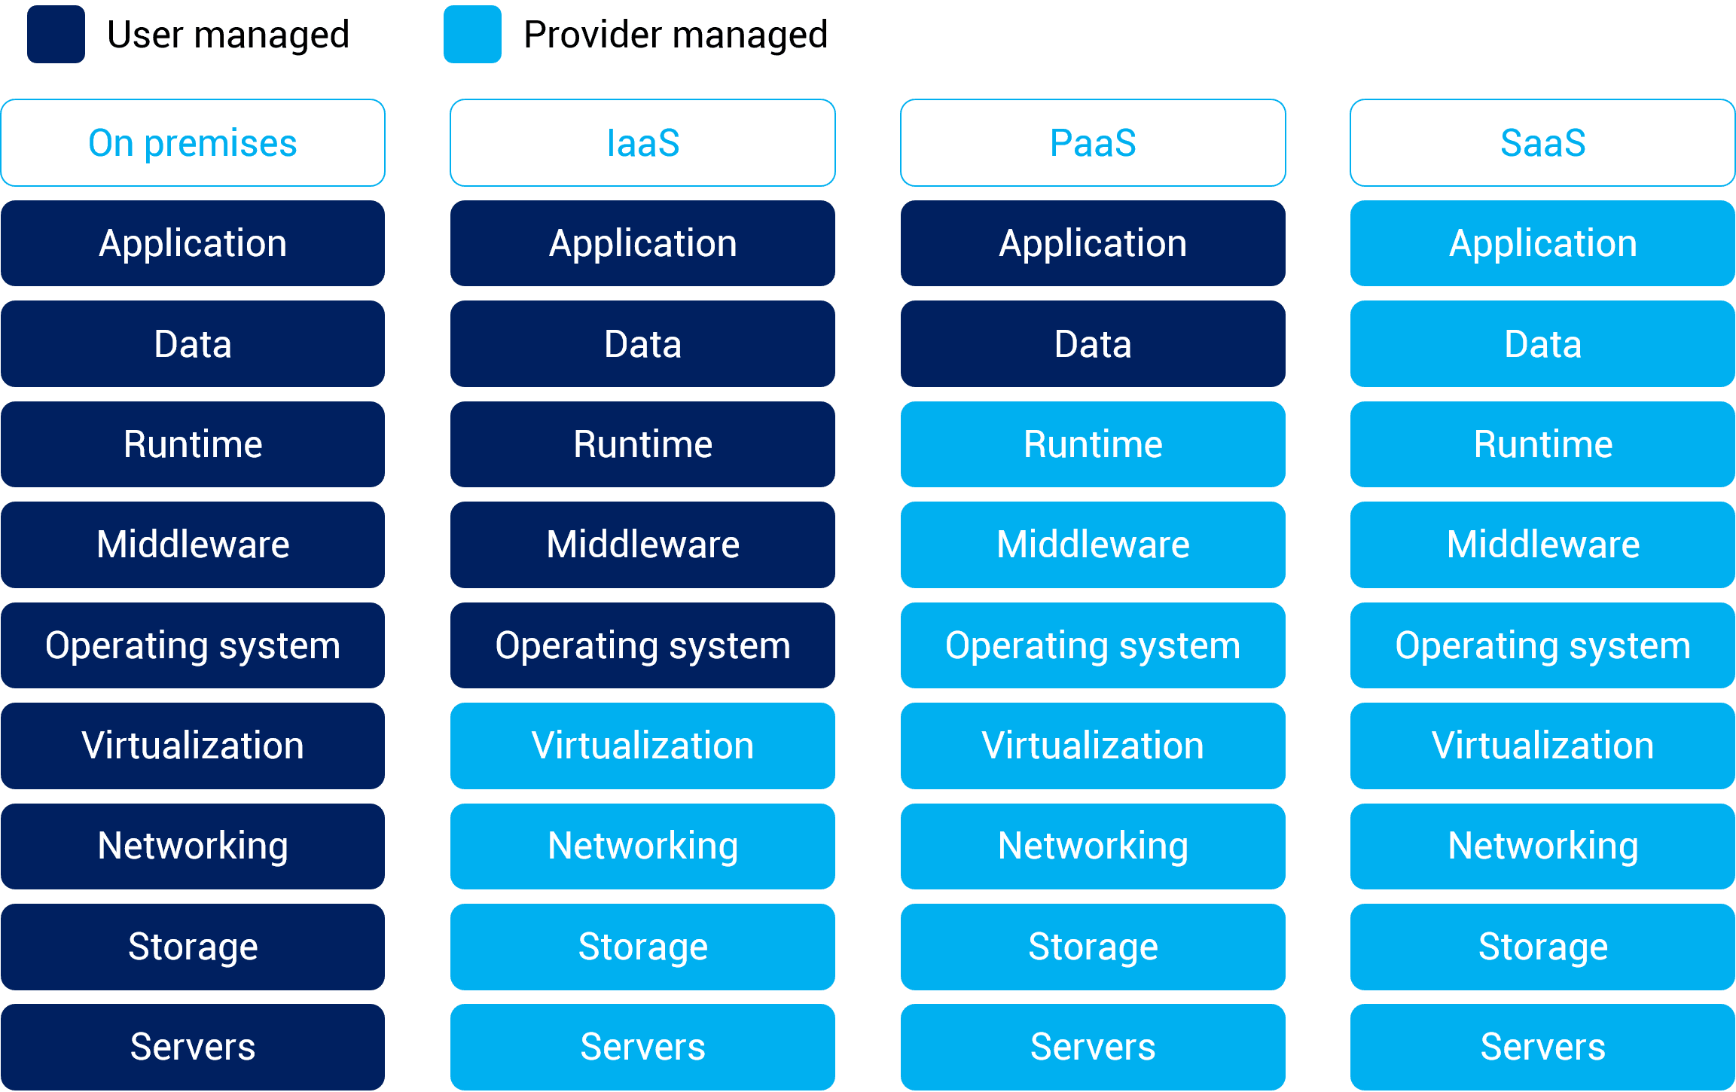
Overview
www.viettel.com.vn
Notes:
vấn đề của on premises:
=> chi phí, con người, khả năng mở rộng

Slide 5
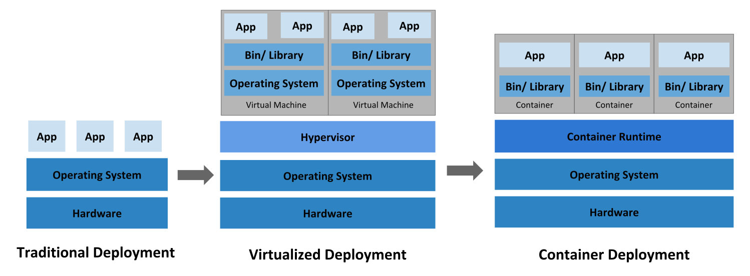
Container Evolutions
www.viettel.com.vn
Notes:
- Đồng nhất môi trường dev test
- đơn giản hóa các thao tác vận hành và triển khai

Slide 6

Container to Containers?
www.viettel.com.vn
Notes:
- Triển khai
- Giám sát
- Vận hành
- Network
- Security
vv

Slide 7
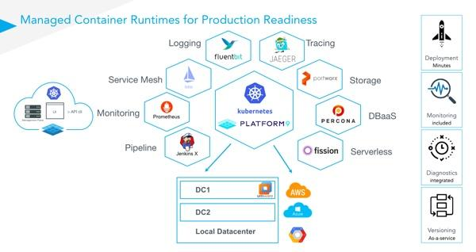
Orchestration tool
www.viettel.com.vn

Slide 8
Kubernetes Overview
www.viettel.com.vn

Slide 9
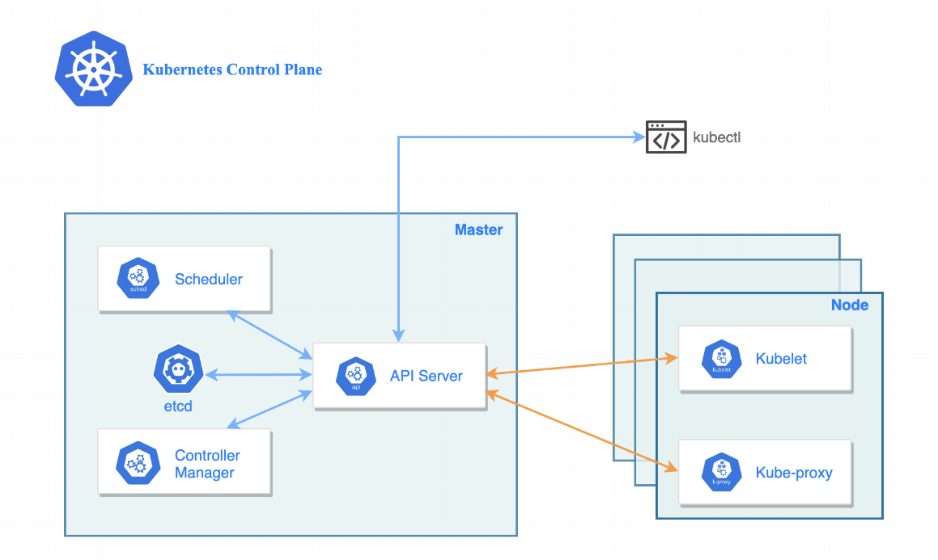
Kubernetes Components
Cluster: A collection of Physical or VMs brought together by K8S and using a shared network to communicate between each server.
Master Node
- A gateway & brain of cluster.
- Health checking.
- Scheduling work
- Orchestrating communication.
Worker Node(s)
- Receives work instructions from master.
- Network & Traffic related works.
- Accepting & running workloads using local and external resources.
www.viettel.com.vn

Slide 10
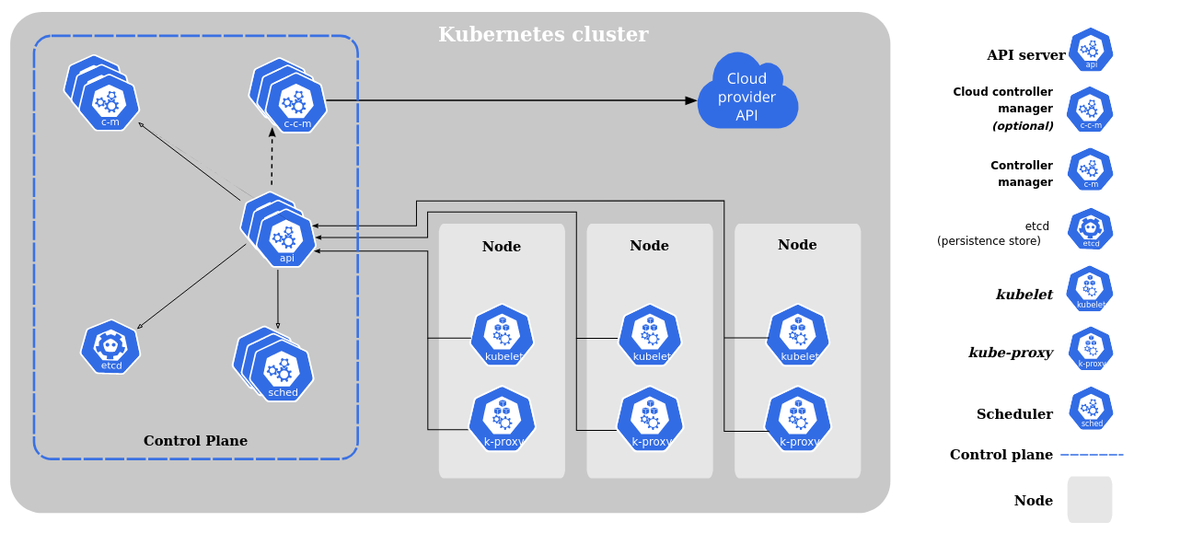
Kubernetes Components
www.viettel.com.vn

Slide 11
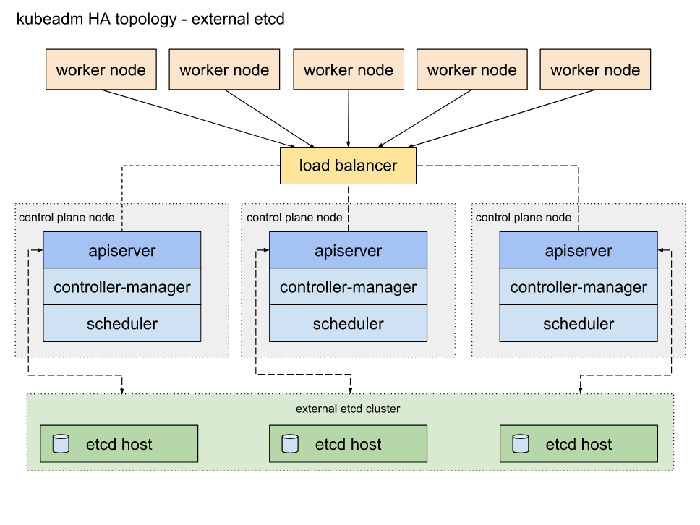
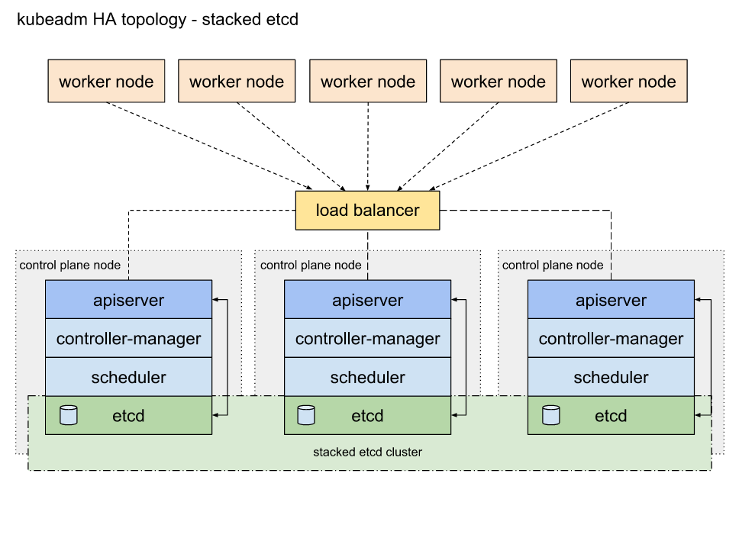
Some Deployment Scenarios
www.viettel.com.vn

Slide 12
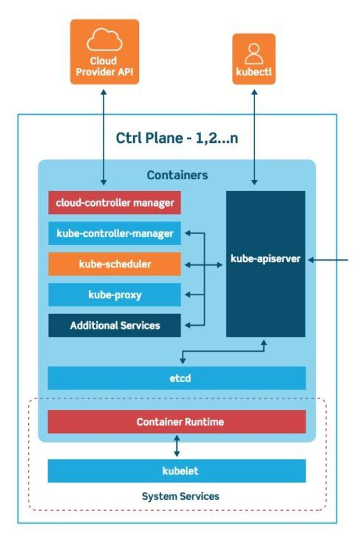
Kubernetes Nodes
Kubernetes Master Nodes: Hosting cluster controller components
www.viettel.com.vn

Slide 13
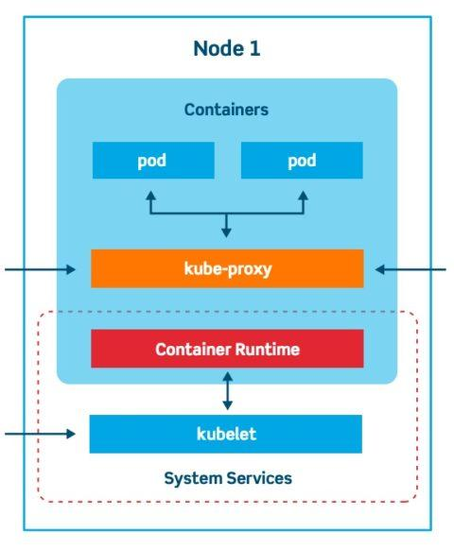
Kubernetes Nodes
Kubernetes Worker Nodes: Hosting cluster workloads
www.viettel.com.vn

Slide 14
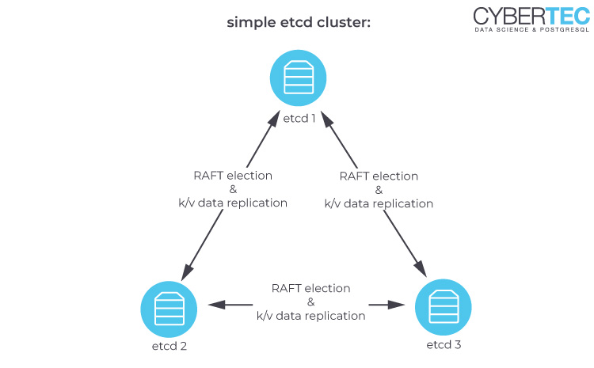
Kubernetes Nodes
(Optional) Etcd Nodes: Cluster Controller Data Storage
www.viettel.com.vn

Slide 15
Kubernetes Control Plane
www.viettel.com.vn

Slide 16
Etcd
Key-Value database
High available
Partition tolerance (with Raft consensus algorithms)
Requires an odd number of nodes for quorum
Sensitive with latency - Need SSD Storage
WATCH function
www.viettel.com.vn
Notes:
https://kube.academy/lessons/etcd
Should have dedicate etcd cluster for each kubernetes cluster
Shouldn’t share etcd cluster with other application
Etcd provide WATCH function for Kube API Server to notify other component (controller manager, kubelet, scheduler) when an resource created/updated or deleted

Slide 17
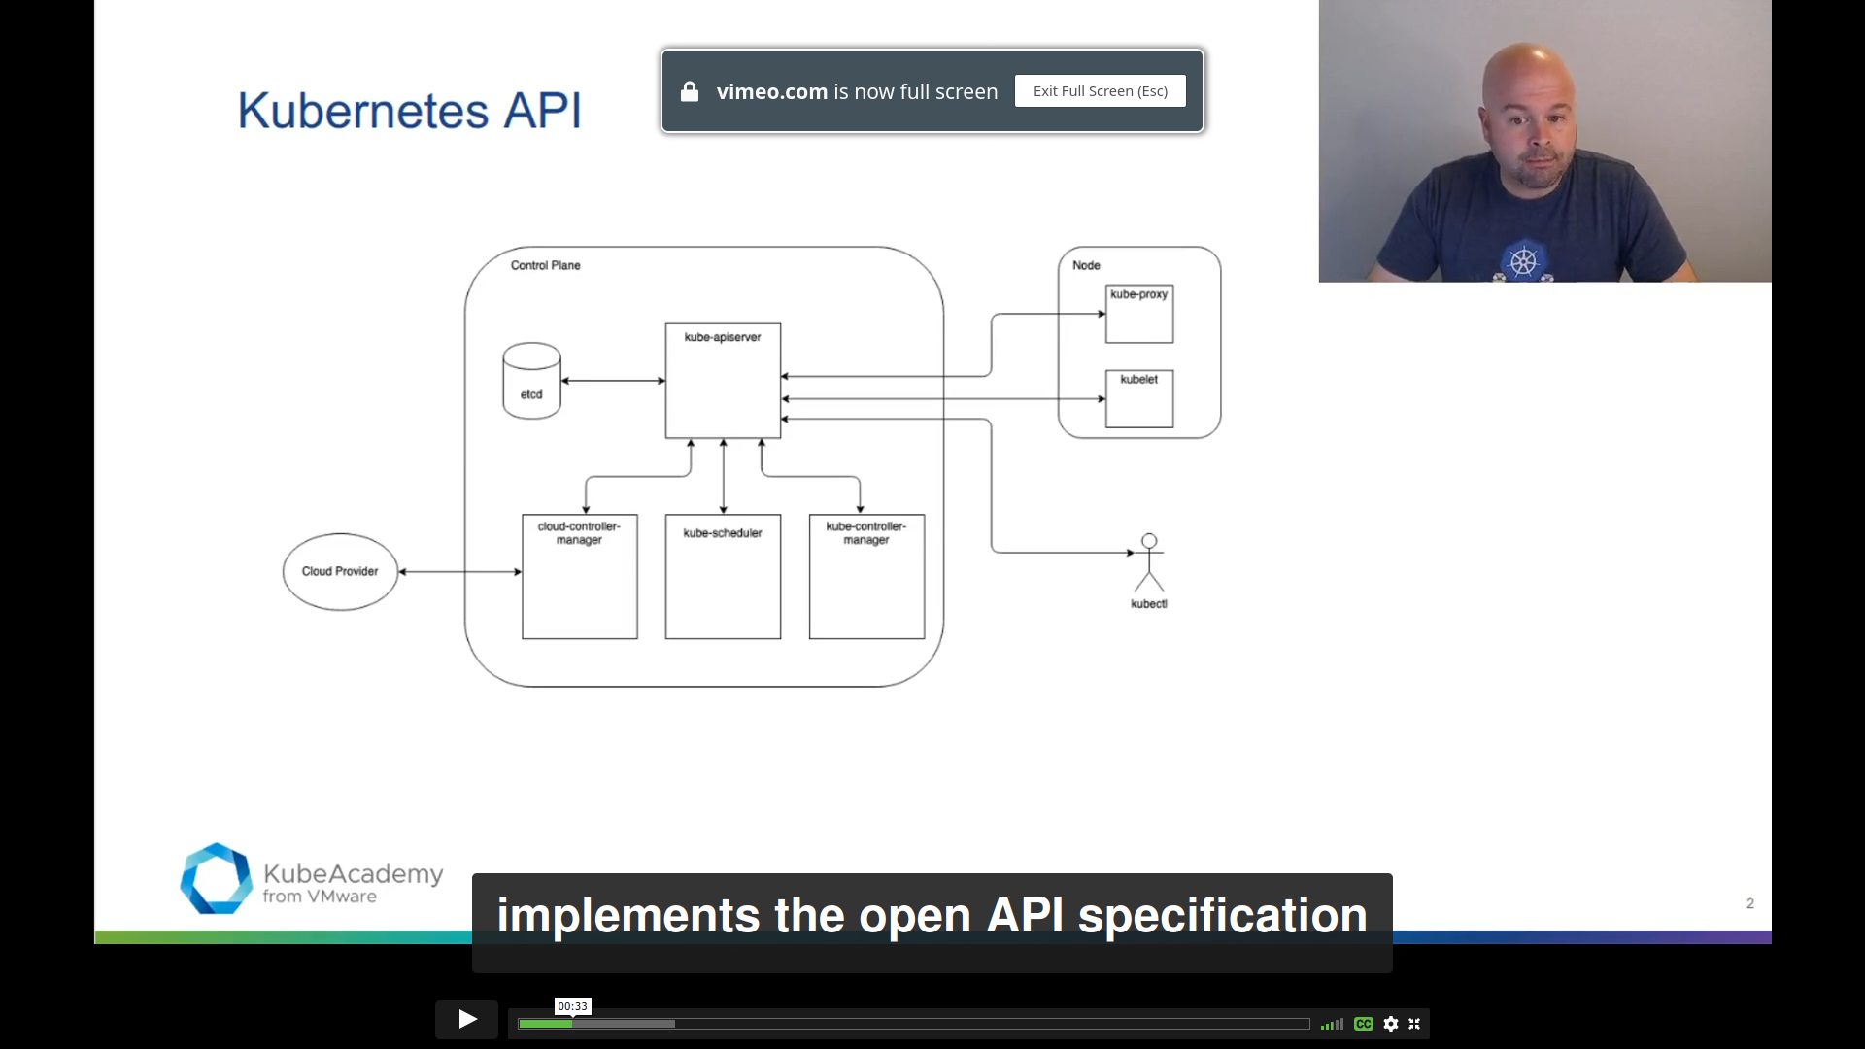
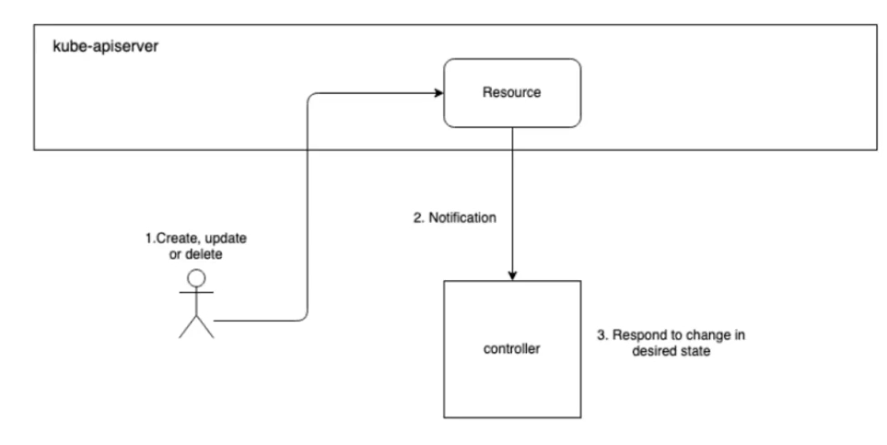
Kubernetes API Server
The Front End of the Kubernetes control plane
Authentication/authorization
Validate object specs
Central Hub for all other control plane components
Manage cluster objects
Notify objects changes
www.viettel.com.vn
Notes:
https://kube.academy/lessons/api-server
The Kubernetes API is the front end of the Kubernetes control plane and is how users interact with their Kubernetes cluster. The API (application programming interface) server determines if a request is valid and then processes it.
In essence, the API is the interface used to manage, create, and configure Kubernetes clusters. It's how the users, external components, and parts of your cluster all communicate with each other.
At the center of the Kubernetes control plane is the API server and the HTTP API that it exposes, allowing you to query and manipulate the state of Kubernetes objects.
https://www.openshift.com/blog/kubernetes-deep-dive-api-server-part-1

Slide 18
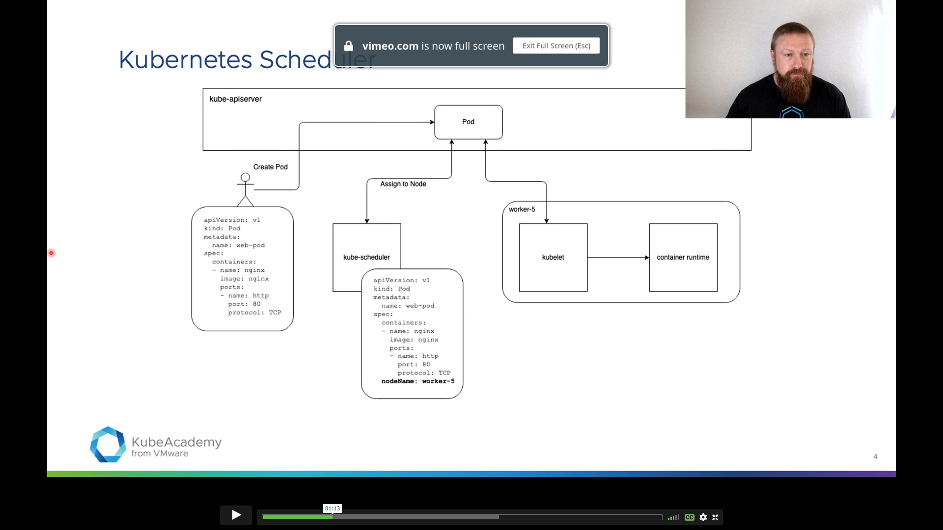
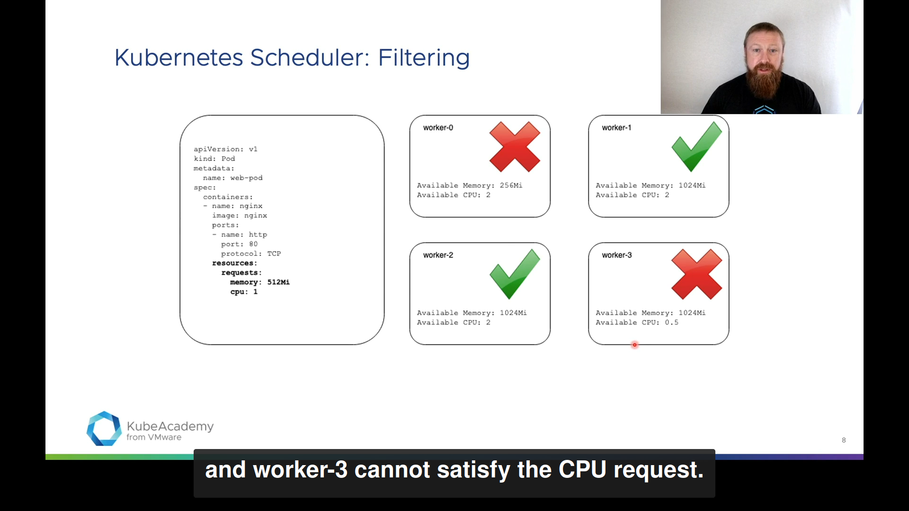
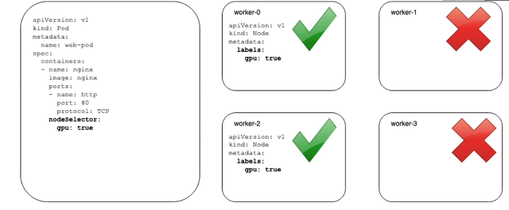
Kubernetes Scheduler
Selects an optimal node for new pods to run
Node selection steps:
Filtering
Scoring
www.viettel.com.vn
Notes:
https://kube.academy/lessons/scheduler
The Kubernetes scheduler is a control plane process which assigns Pods to Nodes. The scheduler determines which Nodes are valid placements for each Pod in the scheduling queue according to constraints and available resources. The scheduler then ranks each valid Node and binds the Pod to a suitable Node. Multiple different schedulers may be used within a cluster; kube-scheduler is the reference implementation. See scheduling for more information about scheduling and the kube-scheduler component.

Slide 19
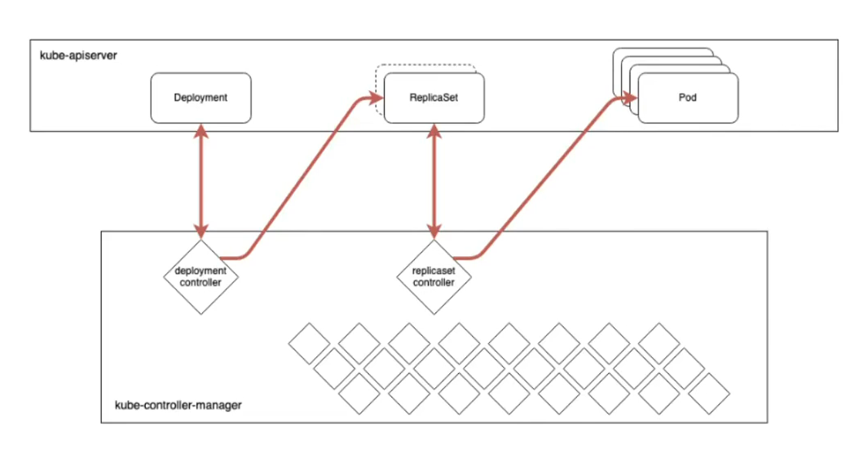
Kubernetes Controller Manager
Kubernetes core control-loop
Watch cluster current state from API Server, and make changes to move to desired state
www.viettel.com.vn
Notes:
https://kube.academy/lessons/controller-manager
The Kubernetes controller manager is a daemon that embeds the core control loops shipped with Kubernetes.
In applications of robotics and automation, a control loop is a non-terminating loop that regulates the state of the system. In Kubernetes, a controller is a control loop that watches the shared state of the cluster through the apiserver and makes changes attempting to move the current state towards the desired state. Examples of controllers that ship with Kubernetes today are the replication controller, endpoints controller, namespace controller, and serviceaccounts controller.

Slide 20
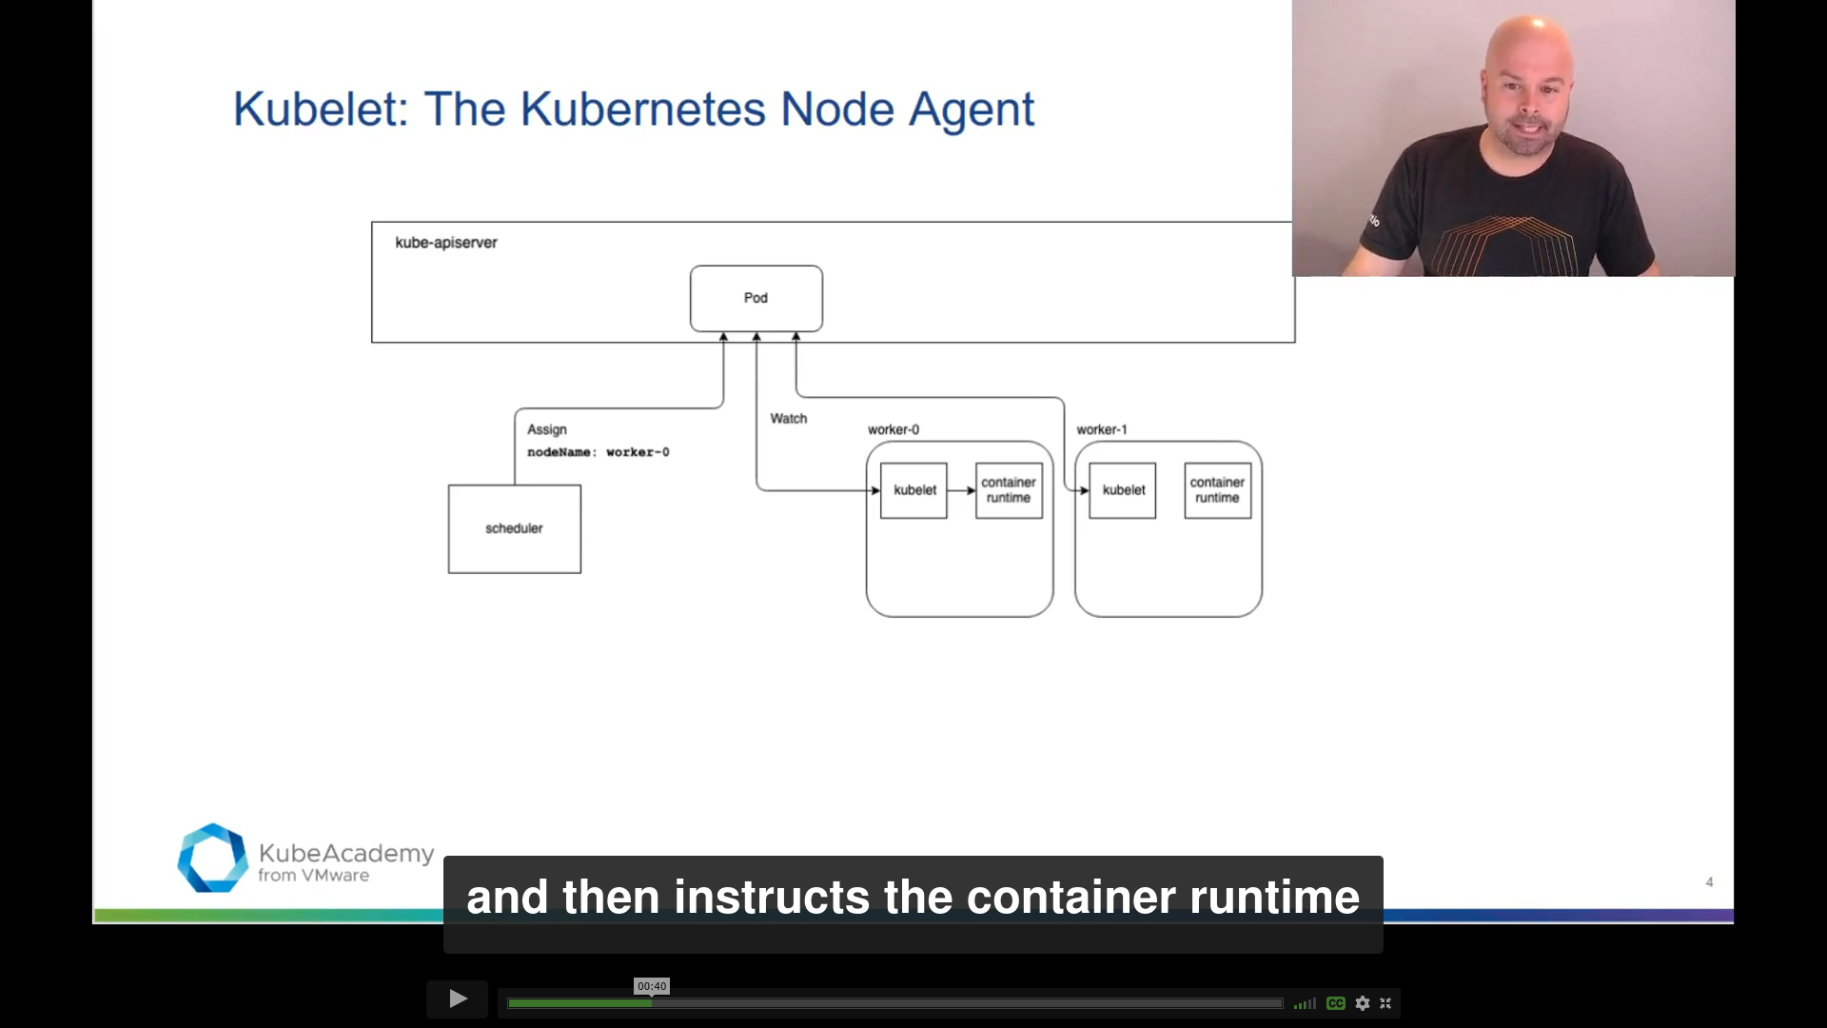
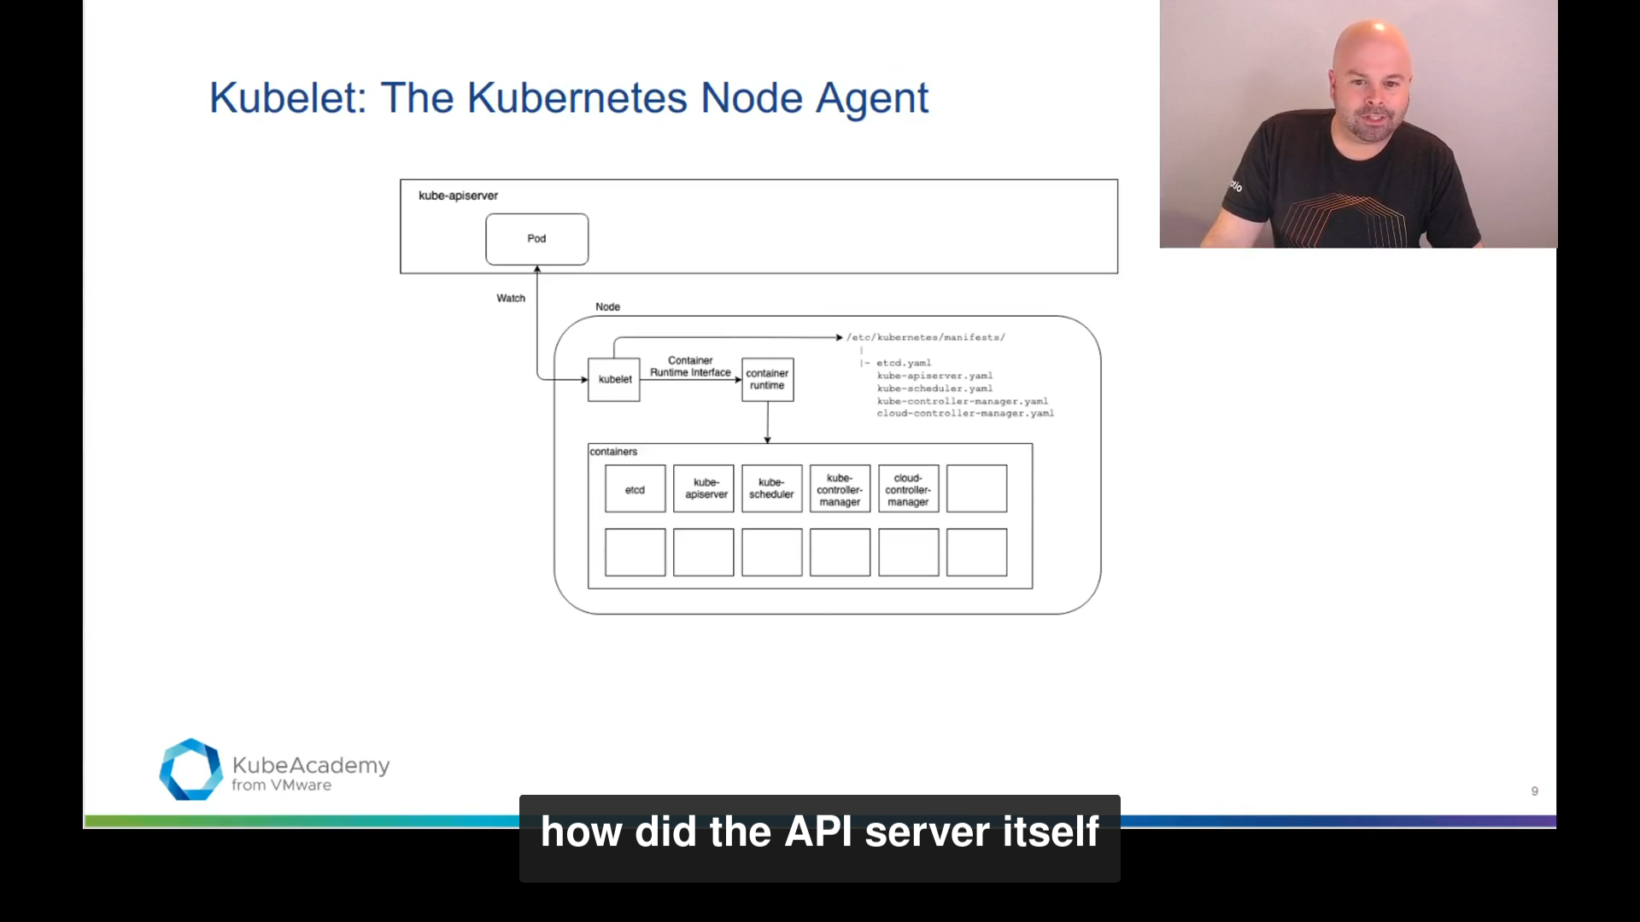
Kubelet
Kubernetes Node Agent
Run as a system service
Registers node with API Server
Manages node pods:
Watching scheduled pods from API Server
Static pods from config files
www.viettel.com.vn
Notes:
https://kube.academy/lessons/kubelet

Slide 21
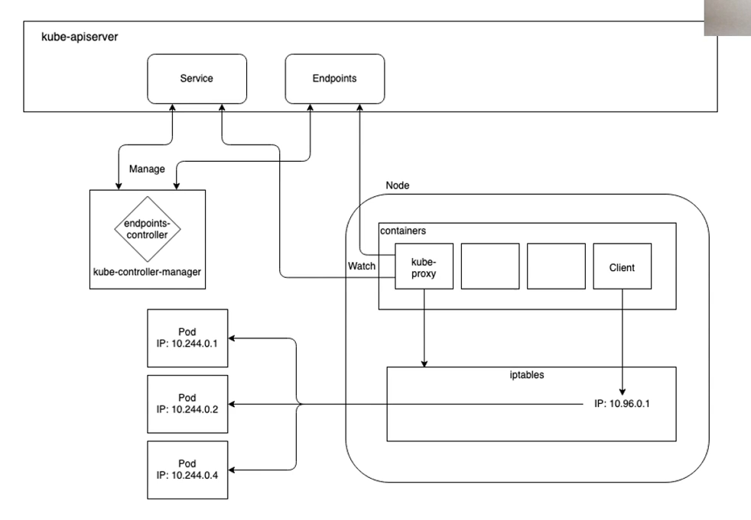
Kube proxy
Runs in every cluster nodes
Implements Service resources
Manages Service resources traffic Forwarding
Using Iptables or IPVS
www.viettel.com.vn
Notes:
https://kube.academy/lessons/kube-proxy
Each node has a kube-proxy container process.
(In the Kubernetes frame of reference, that kube-proxy container is in a pod in the kube-system namespace.)
kube-proxy manages forwarding of traffic addressed to the virtual IP addresses (VIPs) of the cluster’s Kubernetes Service objects to the appropriate backend pods. kube-proxy currently supports three different operation modes:

Slide 22
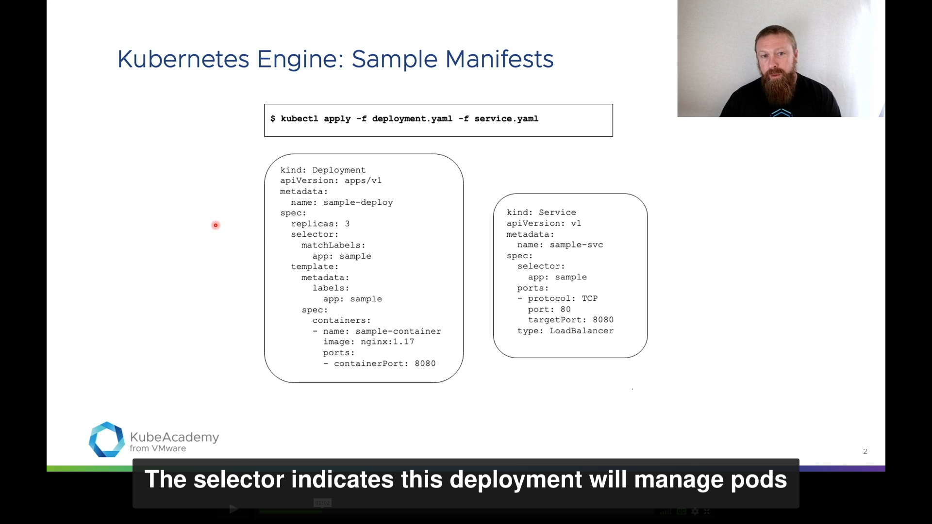
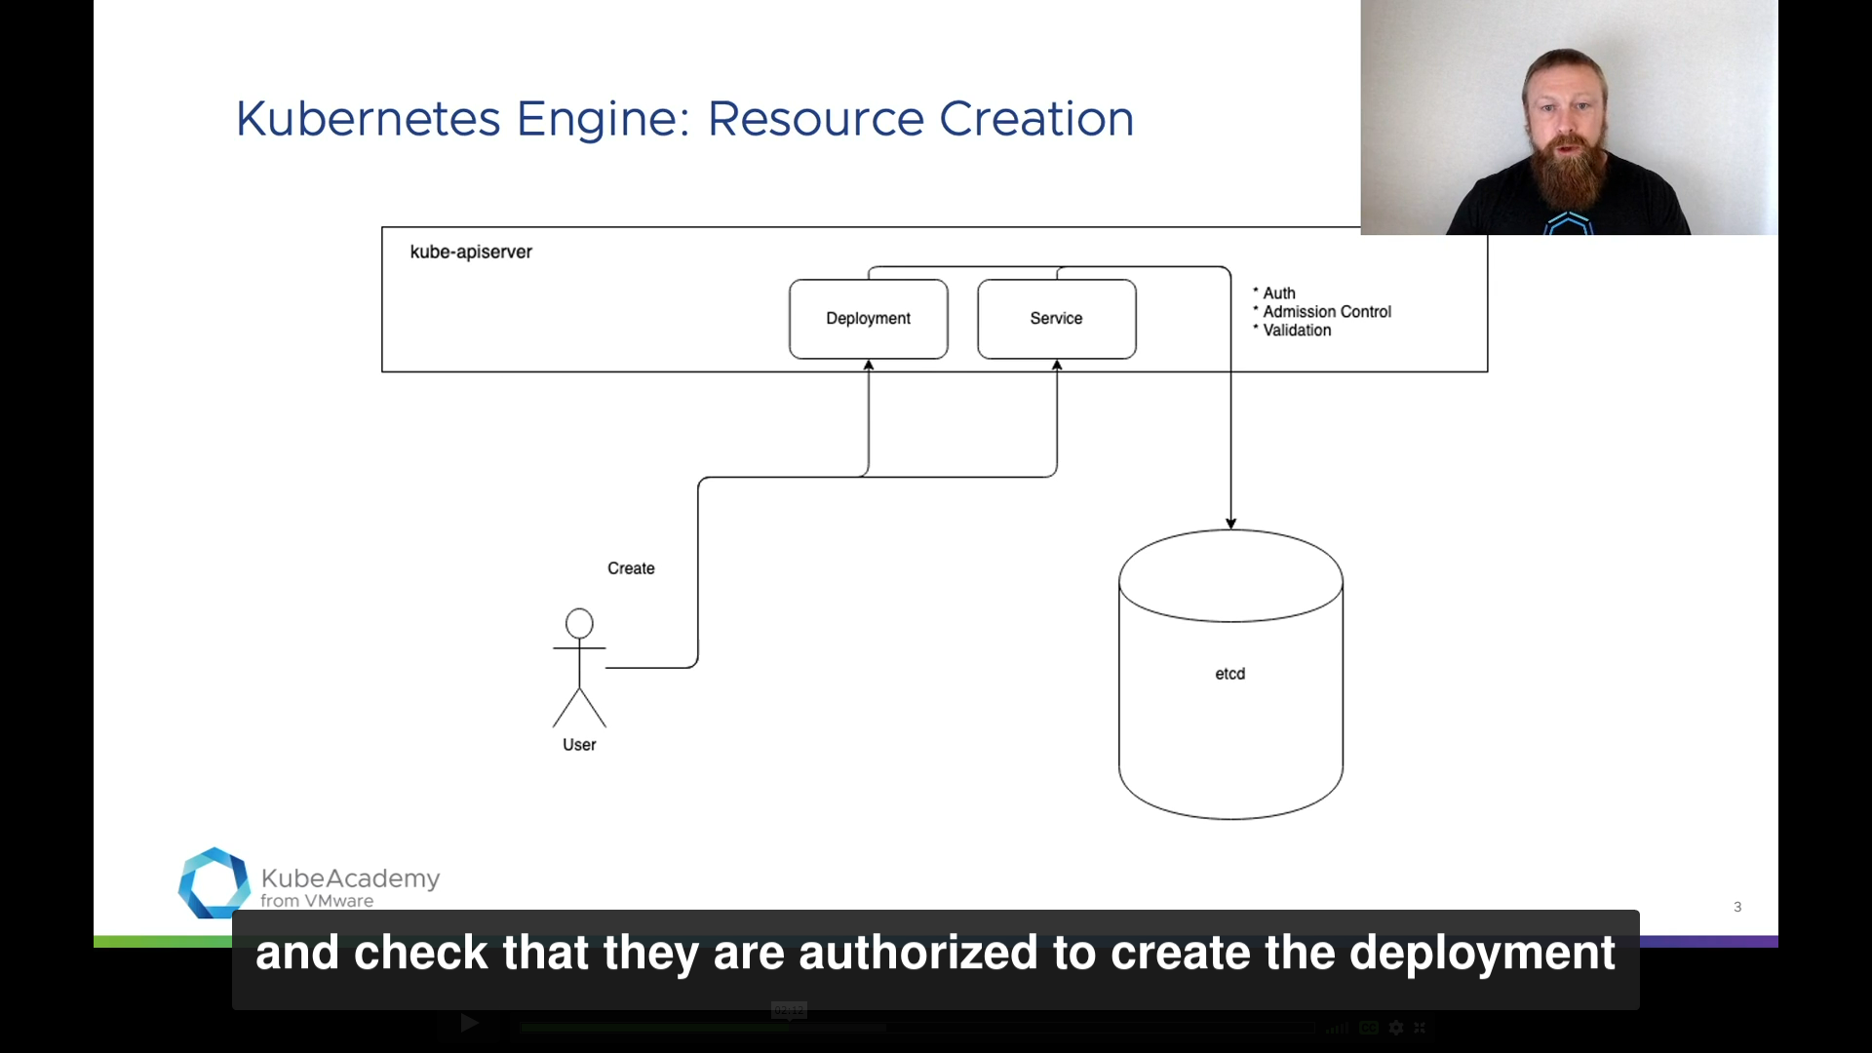
Control Plane - Recap
www.viettel.com.vn
Notes:
https://clusterise.com/articles/kbp-2-certificates/
Kubernetes and the supporting components rely heavily on TLS for security. In this chapter, we will explain the architecture, create multiple certificate authorities and issue all server and client certificates.
The above diagram is simple, yet it conveys a lot of information. For example, it shows that to start an etcd process, we will need:
Certificate for peering (P on the diagram) issued by etcd CA (the large topmost rectangle).
Certificate for the server-side of client connections (CS), also issued by etcd CA.
And also the public etcd CA itself to verify incoming requests.
Similarly, to start a kube-apiserver process, we will need:
Client certificate to authenticate requests to etcd. This effectively functions as a password/token that etcd will verify and eventually grant us access to the data. Since etcd process will be doing the trust-chain verification, this certificate must be issued by etcd CA (as visualized by the large topmost rectangle on the diagram).
Client certificate to authenticate requests to kubelet.
etcd CA to verify server certificates on the client-side. If kube-apiserver didn’t validate the server certificates, we would be open to a man-in-the-middle attack. It would be similar to using plain HTTP instead of HTTPS when visiting a website.
Server certificate issued by Kubernetes CA for the secure API that we want kube-apiserver to expose (the one that defaults to port 6443). This cert is used for TLS and is what makes the API available on HTTPS.
Kubernetes CA to verify incoming requests to the kube-apiserver. This is one of the many authentication methods kube-apiserver provides (such as OIDC and HTTP Authorization).
Both etcd and kube-apiserver authorize incoming requests by validating the trust chain. If we were to use the same CA, certificates issued for etcd could be misused for kube-apiserver and vice versa. The following diagram illustrates why using a single CA is insecure.

Slide 23
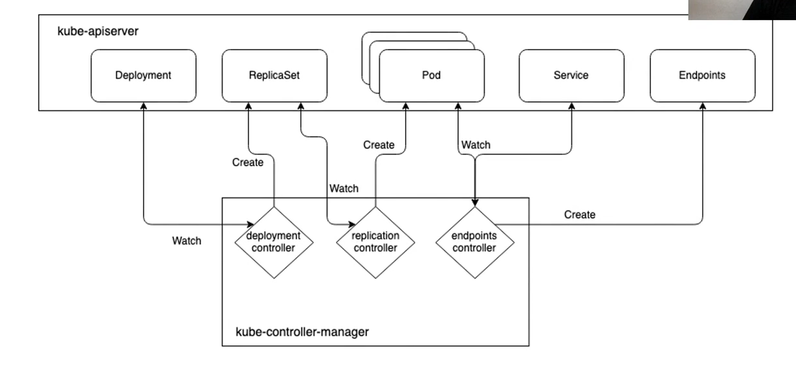
Control Plane - Recap
www.viettel.com.vn

Slide 24
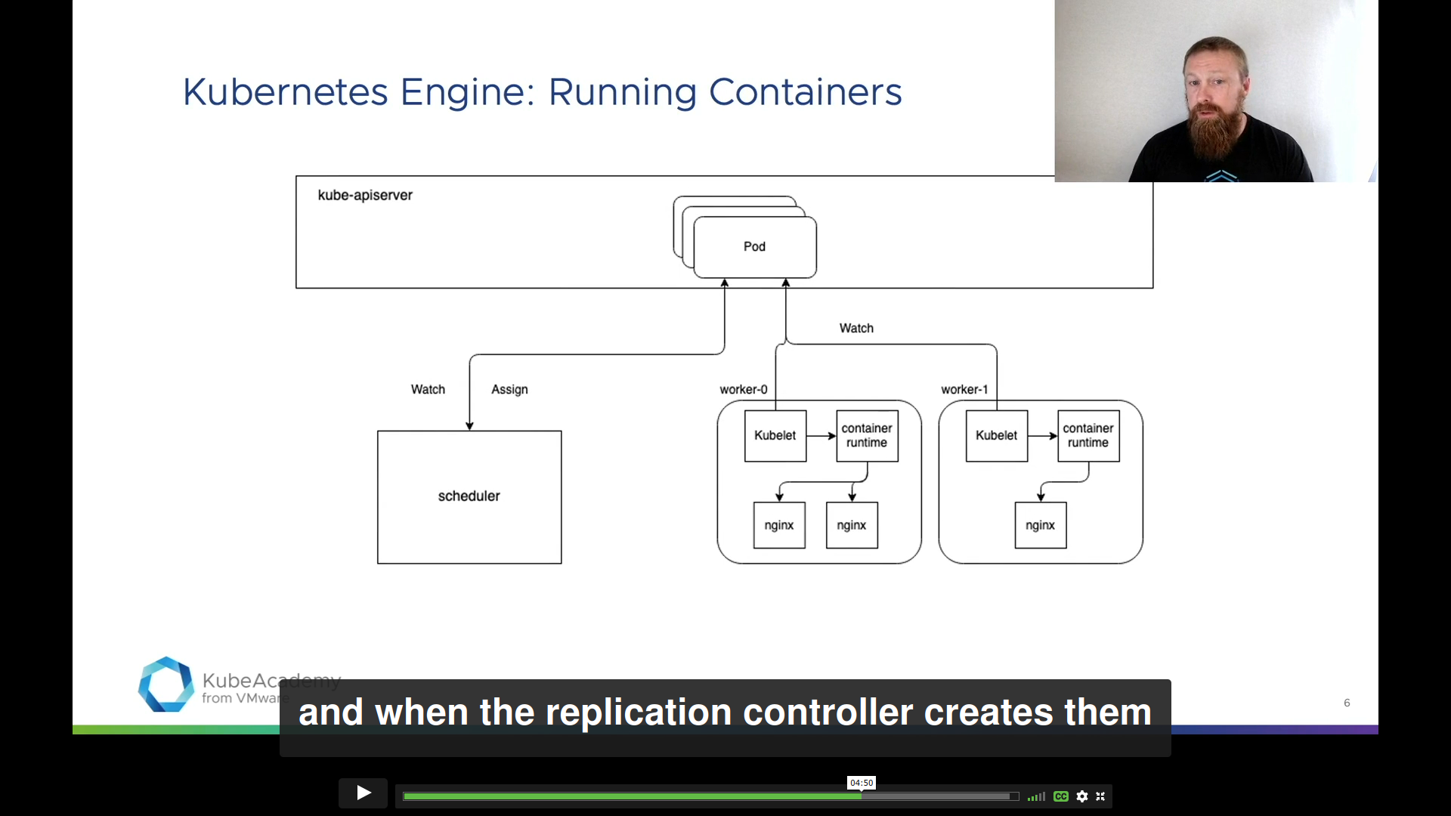
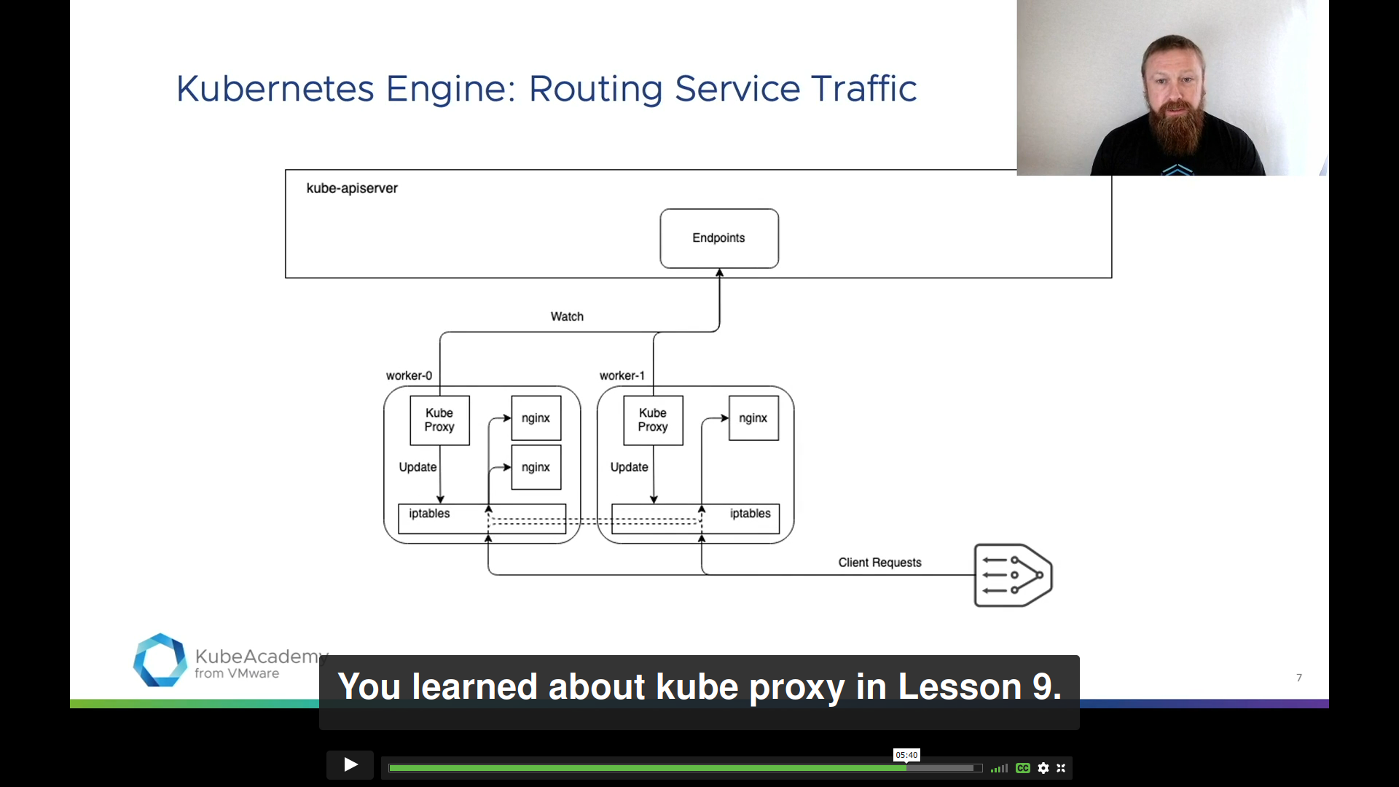
Control Plane - Recap
www.viettel.com.vn
Notes:
https://clusterise.com/articles/kbp-2-certificates/
Kubernetes and the supporting components rely heavily on TLS for security. In this chapter, we will explain the architecture, create multiple certificate authorities and issue all server and client certificates.
The above diagram is simple, yet it conveys a lot of information. For example, it shows that to start an etcd process, we will need:
Certificate for peering (P on the diagram) issued by etcd CA (the large topmost rectangle).
Certificate for the server-side of client connections (CS), also issued by etcd CA.
And also the public etcd CA itself to verify incoming requests.
Similarly, to start a kube-apiserver process, we will need:
Client certificate to authenticate requests to etcd. This effectively functions as a password/token that etcd will verify and eventually grant us access to the data. Since etcd process will be doing the trust-chain verification, this certificate must be issued by etcd CA (as visualized by the large topmost rectangle on the diagram).
Client certificate to authenticate requests to kubelet.
etcd CA to verify server certificates on the client-side. If kube-apiserver didn’t validate the server certificates, we would be open to a man-in-the-middle attack. It would be similar to using plain HTTP instead of HTTPS when visiting a website.
Server certificate issued by Kubernetes CA for the secure API that we want kube-apiserver to expose (the one that defaults to port 6443). This cert is used for TLS and is what makes the API available on HTTPS.
Kubernetes CA to verify incoming requests to the kube-apiserver. This is one of the many authentication methods kube-apiserver provides (such as OIDC and HTTP Authorization).
Both etcd and kube-apiserver authorize incoming requests by validating the trust chain. If we were to use the same CA, certificates issued for etcd could be misused for kube-apiserver and vice versa. The following diagram illustrates why using a single CA is insecure.

Slide 25
Kubernetes Workload Management
www.viettel.com.vn

Slide 26
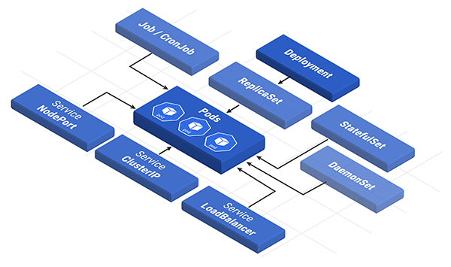
Kubernetes Building Block
“Kubernetes uses additional layers of abstraction over the container interface to provide scaling, resiliency, and life cycle management features”
How user manage containers?
Users define & interact with instances composed of various entities provided by Kubernetes Object Model.
www.viettel.com.vn

Slide 27
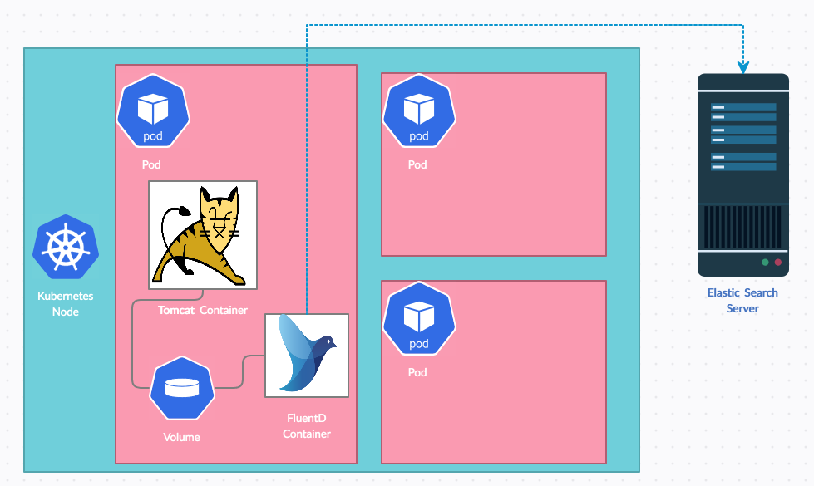
Pod
Smallest unit of work
Run on Nodes
Contains one or more containers
Multi-container Pod:
Deploy in same node
Share same Network IP
Can access to same Volume
www.viettel.com.vn
Notes:
https://kube.academy/lessons/what-is-a-pod

Slide 28
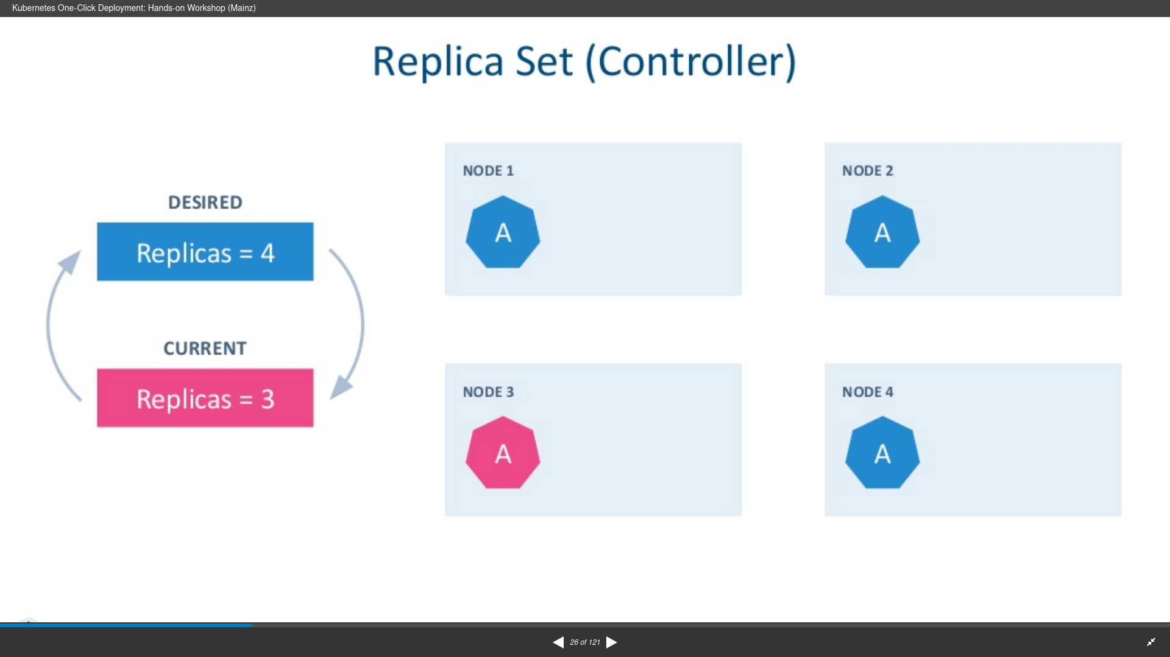
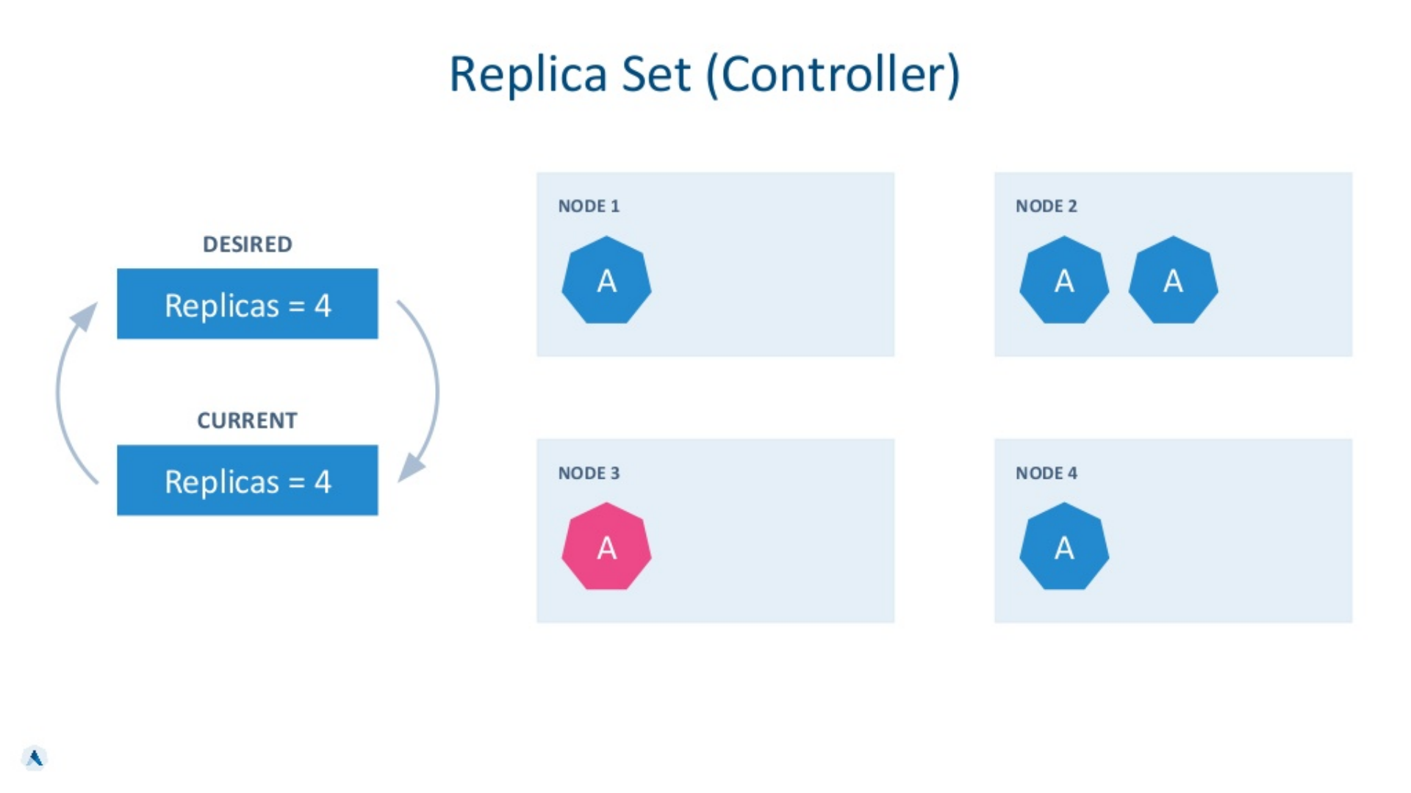
ReplicaSet
Grouping multiple pod instances
Control plane reconcile to ensure ReplicaSet pod number
www.viettel.com.vn

Slide 29
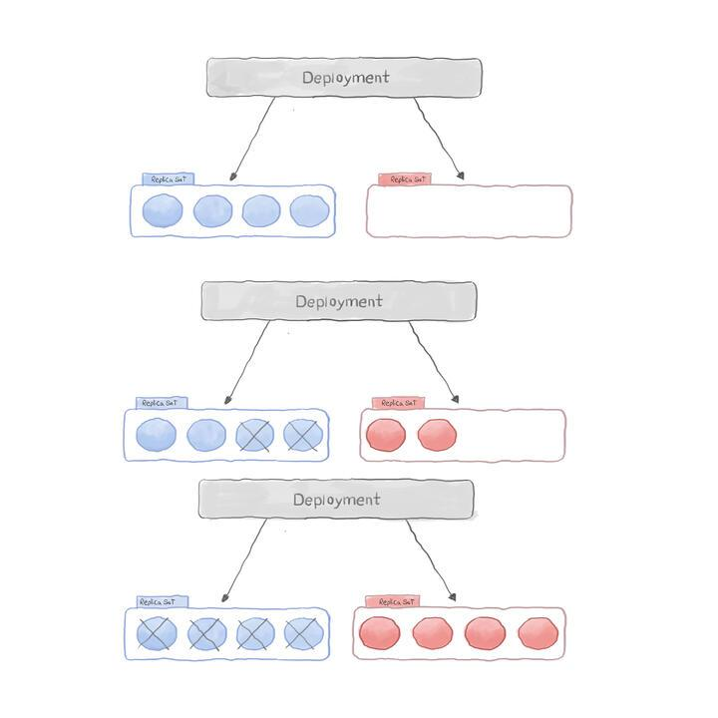
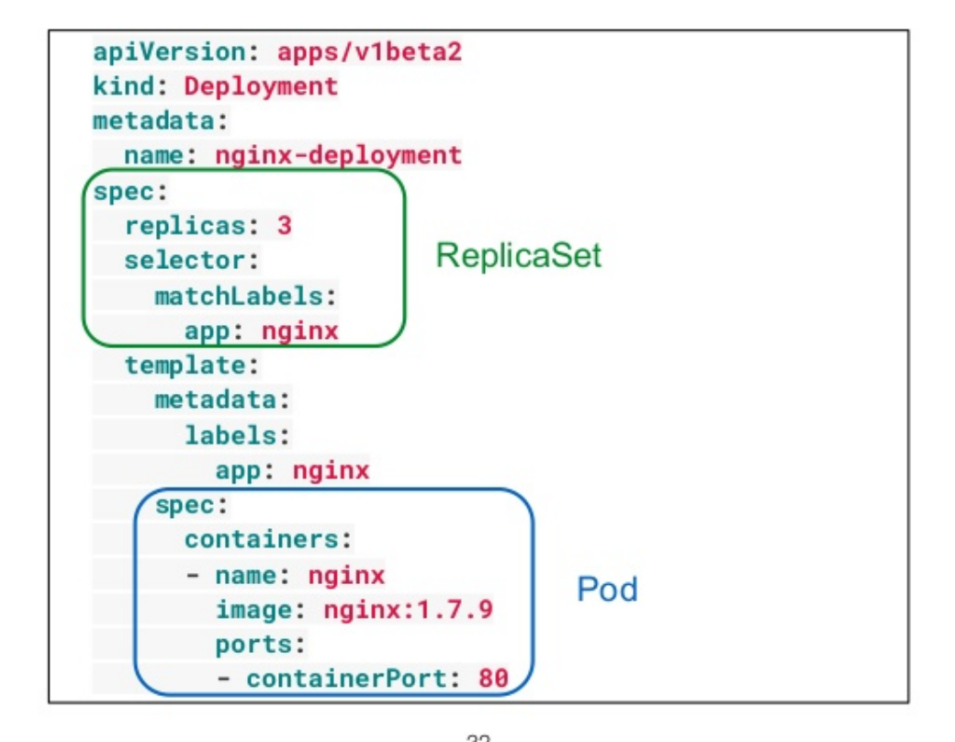
Deployment
Manage Pods via ReplicaSets
Allow rolling updates application
Can rollback when necessary
www.viettel.com.vn
Notes:
https://www.magalix.com/blog/kubernetes-deployments-101
A Deployment is one of the Kubernetes objects that is used to manage Pods via ReplicaSets in a declarative way. It provides updates control as well as rollback functionalities. This means you can update or downgrade an application to the desired version without experiencing a user blackout as well as roll back to the previous version in case the new version is unstable or filled with bugs.
Using a declarative management style for Deployment allows it to bring the desired states of the defined application in a YAML file into reality.
Deployment Features:
A Deployment has the following features:
Create a ReplicaSet and Pods
Update a ReplicaSet
Scale-up/down a Deployment
Pause/continue a Deployment
Rollback to the previous version
Clean up unwanted ReplicaSets

Slide 30
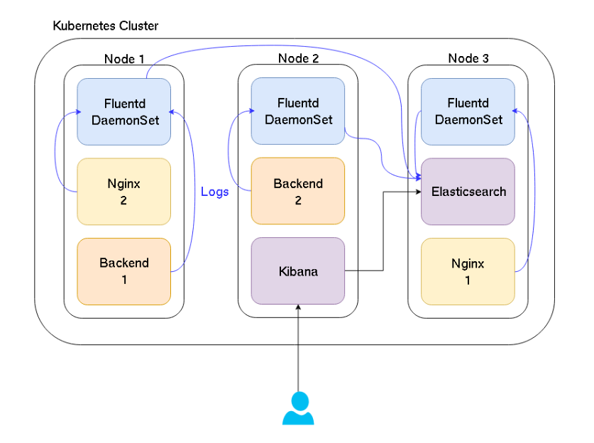
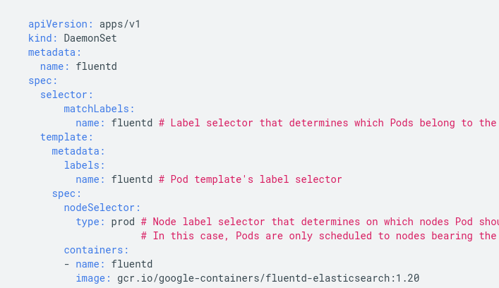
DaemonSet
Ensure all nodes run a specific pod
Use cases:
Monitoring
Logging
Cluster Storage
...
www.viettel.com.vn
Notes:
Like other workload objects, a DaemonSet manages groups of replicated Pods. However, DaemonSets attempt to adhere to a one-Pod-per-node model, either across the entire cluster or a subset of nodes. As you add nodes to a node pool, DaemonSets automatically add Pods to the new nodes as needed.

Slide 31
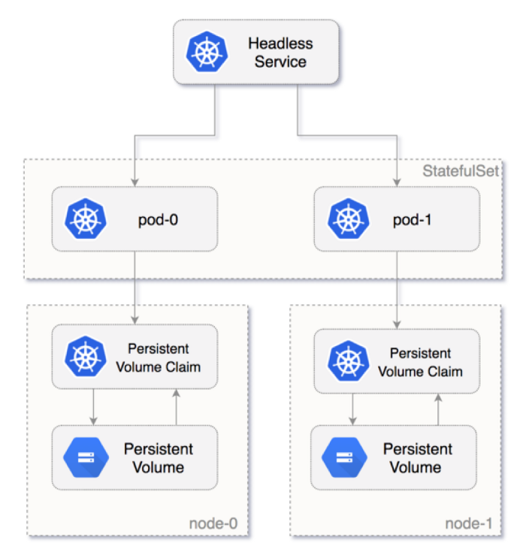
StatefulSet
Manage stateful application pods
Store data in Persistent Volume
Require Cluster Persistent Storage
www.viettel.com.vn
Notes:
StatefulSets in Kubernetes are used for Stateful applications. The pods in StatefulSets are named with unique Identities and stable hostname. It stores the state information and other resilient data in a persistent volume. This persistent volume is attached to Cloud-based storage. It is going to be responsible for maintaining the state of your application.
StatefulSets represent a set of Pods with unique, persistent identities and stable hostnames that GKE maintains regardless of where they are scheduled. The state information and other resilient data for any given StatefulSet Pod is maintained in persistent disk storage associated with the StatefulSet.
StatefulSets use an ordinal index for the identity and ordering of their Pods. By default, StatefulSet Pods are deployed in sequential order and are terminated in reverse ordinal order. For example, a StatefulSet named web has its Pods named web-0, web-1, and web-2. When the web Pod specification is changed, its Pods are gracefully stopped and recreated in an ordered way; in this example, web-2 is terminated first, then web-1, and so on. Alternatively, you can specify the podManagementPolicy: Parallel field to have a StatefulSet launch or terminate all of its Pods in parallel, rather than waiting for Pods to become Running and Ready or to be terminated prior to launching or terminating another Pod.
StatefulSets use a Pod template, which contains a specification for its Pods. The Pod specification determines how each Pod should look: what applications should run inside its containers, which volumes it should mount, its labels and selectors, and more.

Slide 32
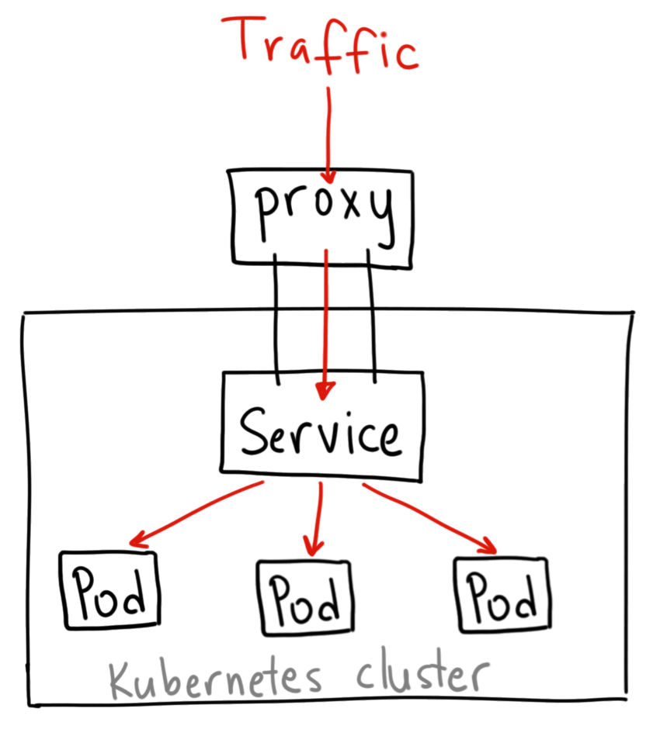
Kubernetes Service
Abstract way to expose an application running on a set of Pods
Service Type:
Cluster IP
NodePort
LoadBalancer
Ingress
www.viettel.com.vn
Notes:
StatefulSets in Kubernetes are used for Stateful applications. The pods in StatefulSets are named with unique Identities and stable hostname. It stores the state information and other resilient data in a persistent volume. This persistent volume is attached to Cloud-based storage. It is going to be responsible for maintaining the state of your application.
StatefulSets represent a set of Pods with unique, persistent identities and stable hostnames that GKE maintains regardless of where they are scheduled. The state information and other resilient data for any given StatefulSet Pod is maintained in persistent disk storage associated with the StatefulSet.
StatefulSets use an ordinal index for the identity and ordering of their Pods. By default, StatefulSet Pods are deployed in sequential order and are terminated in reverse ordinal order. For example, a StatefulSet named web has its Pods named web-0, web-1, and web-2. When the web Pod specification is changed, its Pods are gracefully stopped and recreated in an ordered way; in this example, web-2 is terminated first, then web-1, and so on. Alternatively, you can specify the podManagementPolicy: Parallel field to have a StatefulSet launch or terminate all of its Pods in parallel, rather than waiting for Pods to become Running and Ready or to be terminated prior to launching or terminating another Pod.
StatefulSets use a Pod template, which contains a specification for its Pods. The Pod specification determines how each Pod should look: what applications should run inside its containers, which volumes it should mount, its labels and selectors, and more.

Slide 33
Cluster IP
Exposes the Service on a cluster-internal IP
apiVersion: v1
kind: Service
metadata:
name: my-internal-service
spec:
selector:
app: my-app
type: ClusterIP
ports:
- name: http
port: 80
targetPort: 80
protocol: TCP
www.viettel.com.vn
Notes:
StatefulSets in Kubernetes are used for Stateful applications. The pods in StatefulSets are named with unique Identities and stable hostname. It stores the state information and other resilient data in a persistent volume. This persistent volume is attached to Cloud-based storage. It is going to be responsible for maintaining the state of your application.
StatefulSets represent a set of Pods with unique, persistent identities and stable hostnames that GKE maintains regardless of where they are scheduled. The state information and other resilient data for any given StatefulSet Pod is maintained in persistent disk storage associated with the StatefulSet.
StatefulSets use an ordinal index for the identity and ordering of their Pods. By default, StatefulSet Pods are deployed in sequential order and are terminated in reverse ordinal order. For example, a StatefulSet named web has its Pods named web-0, web-1, and web-2. When the web Pod specification is changed, its Pods are gracefully stopped and recreated in an ordered way; in this example, web-2 is terminated first, then web-1, and so on. Alternatively, you can specify the podManagementPolicy: Parallel field to have a StatefulSet launch or terminate all of its Pods in parallel, rather than waiting for Pods to become Running and Ready or to be terminated prior to launching or terminating another Pod.
StatefulSets use a Pod template, which contains a specification for its Pods. The Pod specification determines how each Pod should look: what applications should run inside its containers, which volumes it should mount, its labels and selectors, and more.

Slide 34
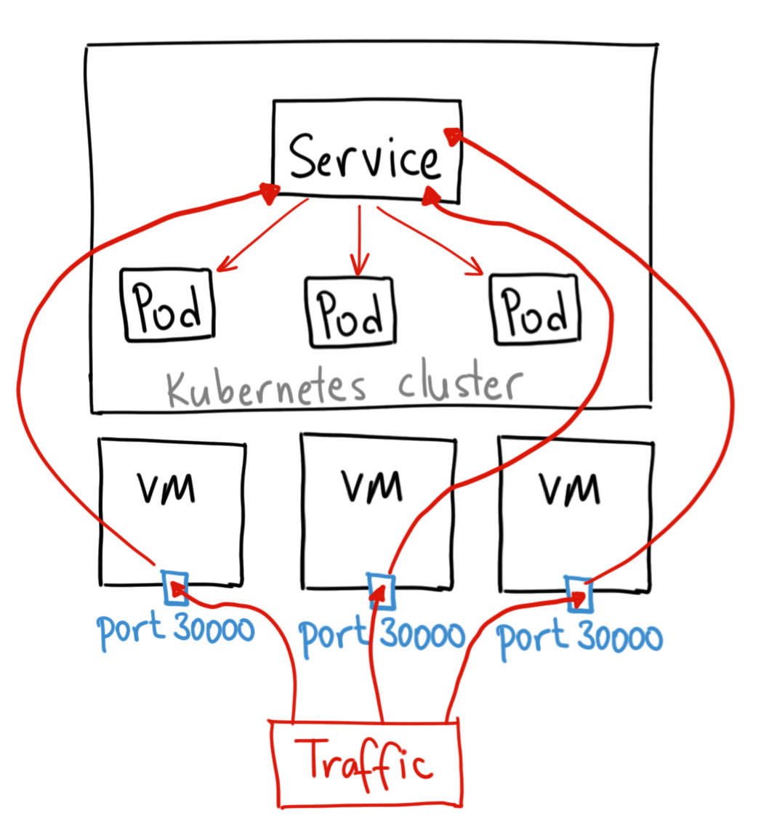
Nodeport
Exposes the Service on Node’s IP at a static port
apiVersion: v1
kind: Service
metadata:
name: my-nodeport-service
spec:
selector:
app: my-app
type: NodePort
ports:
- name: http
port: 80
targetPort: 80
nodePort: 30036
protocol: TCP
www.viettel.com.vn
Notes:
StatefulSets in Kubernetes are used for Stateful applications. The pods in StatefulSets are named with unique Identities and stable hostname. It stores the state information and other resilient data in a persistent volume. This persistent volume is attached to Cloud-based storage. It is going to be responsible for maintaining the state of your application.
StatefulSets represent a set of Pods with unique, persistent identities and stable hostnames that GKE maintains regardless of where they are scheduled. The state information and other resilient data for any given StatefulSet Pod is maintained in persistent disk storage associated with the StatefulSet.
StatefulSets use an ordinal index for the identity and ordering of their Pods. By default, StatefulSet Pods are deployed in sequential order and are terminated in reverse ordinal order. For example, a StatefulSet named web has its Pods named web-0, web-1, and web-2. When the web Pod specification is changed, its Pods are gracefully stopped and recreated in an ordered way; in this example, web-2 is terminated first, then web-1, and so on. Alternatively, you can specify the podManagementPolicy: Parallel field to have a StatefulSet launch or terminate all of its Pods in parallel, rather than waiting for Pods to become Running and Ready or to be terminated prior to launching or terminating another Pod.
StatefulSets use a Pod template, which contains a specification for its Pods. The Pod specification determines how each Pod should look: what applications should run inside its containers, which volumes it should mount, its labels and selectors, and more.

Slide 35
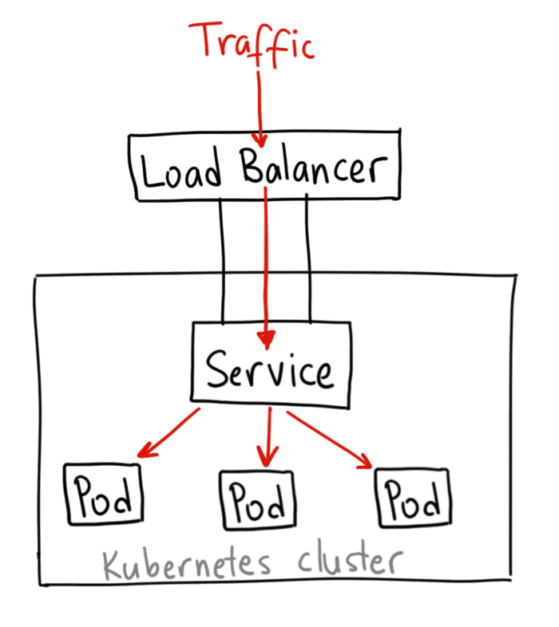
LoadBalancer
Exposes the Service externally using a cloud provider’s load balancer
apiVersion: v1
kind: Service
metadata:
name: my-lb-service
spec:
selector:
app: my-app
type: LoadBalancer
ports:
- name: http
port: 80
targetPort: 80
www.viettel.com.vn
Notes:
StatefulSets in Kubernetes are used for Stateful applications. The pods in StatefulSets are named with unique Identities and stable hostname. It stores the state information and other resilient data in a persistent volume. This persistent volume is attached to Cloud-based storage. It is going to be responsible for maintaining the state of your application.
StatefulSets represent a set of Pods with unique, persistent identities and stable hostnames that GKE maintains regardless of where they are scheduled. The state information and other resilient data for any given StatefulSet Pod is maintained in persistent disk storage associated with the StatefulSet.
StatefulSets use an ordinal index for the identity and ordering of their Pods. By default, StatefulSet Pods are deployed in sequential order and are terminated in reverse ordinal order. For example, a StatefulSet named web has its Pods named web-0, web-1, and web-2. When the web Pod specification is changed, its Pods are gracefully stopped and recreated in an ordered way; in this example, web-2 is terminated first, then web-1, and so on. Alternatively, you can specify the podManagementPolicy: Parallel field to have a StatefulSet launch or terminate all of its Pods in parallel, rather than waiting for Pods to become Running and Ready or to be terminated prior to launching or terminating another Pod.
StatefulSets use a Pod template, which contains a specification for its Pods. The Pod specification determines how each Pod should look: what applications should run inside its containers, which volumes it should mount, its labels and selectors, and more.

Slide 36
Workload Utilities
ConfigMaps
Namespace
www.viettel.com.vn
Notes:
https://kube.academy/lessons/what-is-a-pod

Slide 37
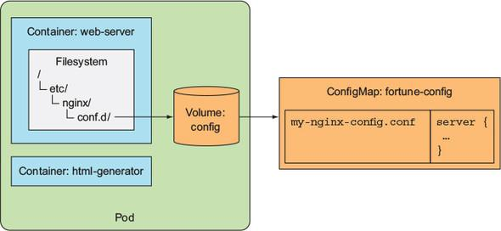
ConfigMap
Store Application Configuration
Separate from application code
Mount to application pods as a volume at runtime
apiVersion: v1
kind: ConfigMap
metadata:
name: game-demo
data:
# property-like keys; each key maps to a simple value
player_initial_lives: "3"
ui_properties_file_name: "user-interface.properties"
# file-like keys
game.properties: |
enemy.types=aliens,monsters
player.maximum-lives=5
user-interface.properties: |
color.good=purple
color.bad=yellow
allow.textmode=true
volumeMounts:
- name: config
mountPath: "/config"
readOnly: true
volumes:
# You set volumes at the Pod level,
# then mount them into containers inside that Pod
- name: config
configMap:
# Provide the name of the ConfigMap you want to mount.
name: game-demo
# An array of keys from the ConfigMap to create as files
items:
- key: "game.properties"
path: "game.properties"
- key: "user-interface.properties"
path: "user-interface.properties"
www.viettel.com.vn
Notes:
A ConfigMap is an API object that lets you store configuration for other objects to use. Unlike most Kubernetes objects that have a spec, a ConfigMap has data and binaryData fields. These fields accept key-value pairs as their values. Both the data field and the binaryData are optional. The data field is designed to contain UTF-8 byte sequences while the binaryData field is designed to contain binary data as base64-encoded strings.
The name of a ConfigMap must be a valid DNS subdomain name.
Each key under the data or the binaryData field must consist of alphanumeric characters, -, _ or .. The keys stored in data must not overlap with the keys in the binaryData field.
Starting from v1.19, you can add an immutable field to a ConfigMap definition to create an immutable ConfigMap

Slide 38
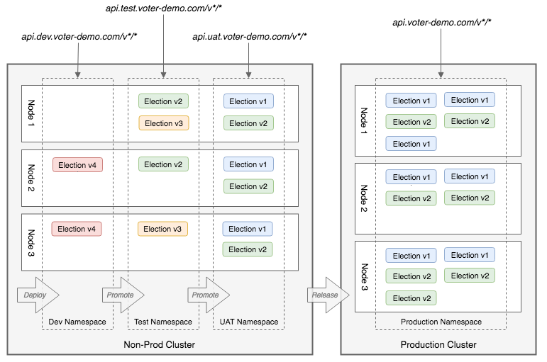
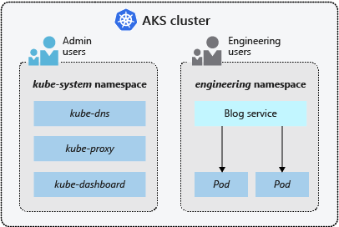
Namespace
Different “virtual clusters” for each users
Implement RBAC for cluster resources
Isolate different environments in same cluster
www.viettel.com.vn
Notes:
https://www.vmware.com/topics/glossary/content/kubernetes-namespace
Namespaces are a way to organize clusters into virtual sub-clusters — they can be helpful when different teams or projects share a Kubernetes cluster. Any number of namespaces are supported within a cluster, each logically separated from others but with the ability to communicate with each other. Namespaces cannot be nested within each other.
There are many use cases for Kubernetes namespaces, including:
Allowing teams or projects to exist in their own virtual clusters without fear of impacting each other’s work.
Enhancing role-based access controls (RBAC) by limiting users and processes to certain namespaces.
Enabling the dividing of a cluster’s resources between multiple teams and users via resource quotas.
Providing an easy method of separating development, testing, and deployment of containerized applications enabling the entire lifecycle to take place on the same cluster.

Slide 39
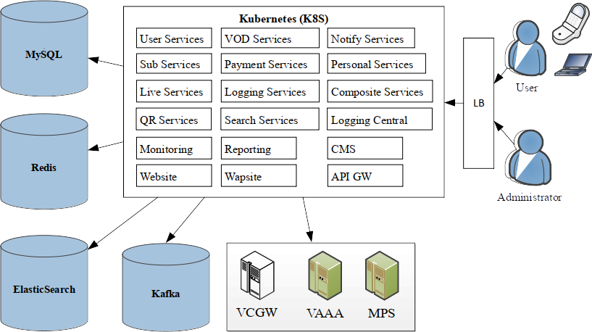
TV360 workload management on K8S Cluster
TV360 use-case
www.viettel.com.vn

Slide 40
Kubernetes Networking
www.viettel.com.vn

Slide 41
Traffic types in a K8S Cluster
Pod to Pod networking
Pod to Service networking
External user to Pod networking
www.viettel.com.vn
Notes:
Each Pod is assigned a unique IP address for each address family. Every container in a Pod shares the network namespace, including the IP address and network ports. Inside a Pod (and only then), the containers that belong to the Pod can communicate with one another using localhost. When containers in a Pod communicate with entities outside the Pod, they must coordinate how they use the shared network resources (such as ports). Within a Pod, containers share an IP address and port space, and can find each other via localhost. The containers in a Pod can also communicate with each other using standard inter-process communications like SystemV semaphores or POSIX shared memory. Containers in different Pods have distinct IP addresses and can not communicate by IPC without special configuration. Containers that want to interact with a container running in a different Pod can use IP networking to communicate.
Containers within the Pod see the system hostname as being the same as the configured name for the Pod. There's more about this in the networking section

Slide 42
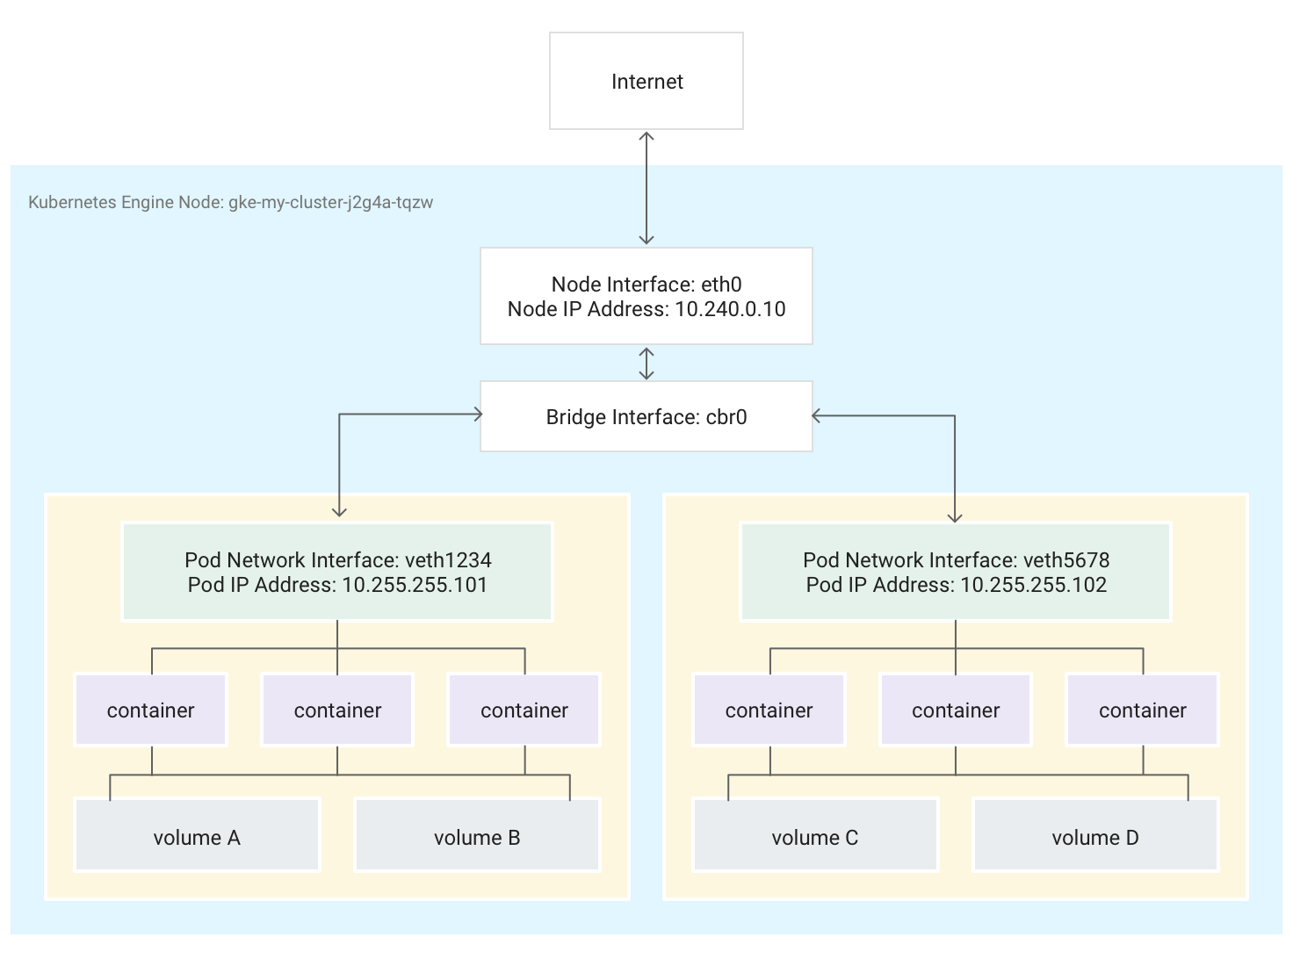
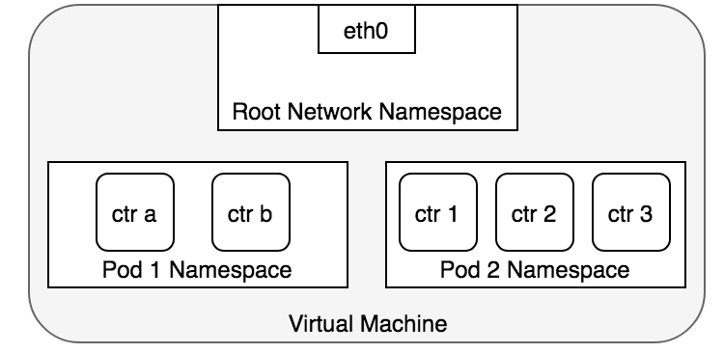
Pod networking - basic
Container in same pod
Pods in same node separated by network namespace
Each node has it own pod subnet
www.viettel.com.vn
Notes:
Each Pod is assigned a unique IP address for each address family. Every container in a Pod shares the network namespace, including the IP address and network ports. Inside a Pod (and only then), the containers that belong to the Pod can communicate with one another using localhost. When containers in a Pod communicate with entities outside the Pod, they must coordinate how they use the shared network resources (such as ports). Within a Pod, containers share an IP address and port space, and can find each other via localhost. The containers in a Pod can also communicate with each other using standard inter-process communications like SystemV semaphores or POSIX shared memory. Containers in different Pods have distinct IP addresses and can not communicate by IPC without special configuration. Containers that want to interact with a container running in a different Pod can use IP networking to communicate.
Containers within the Pod see the system hostname as being the same as the configured name for the Pod. There's more about this in the networking section

Slide 43
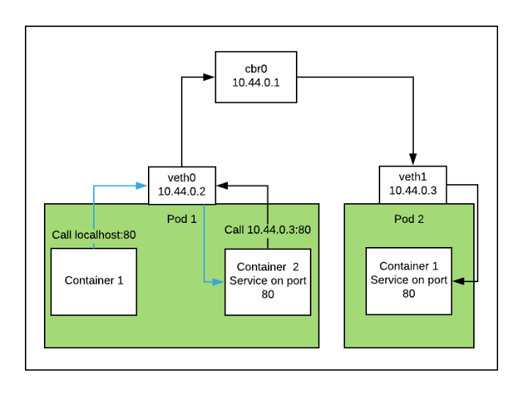
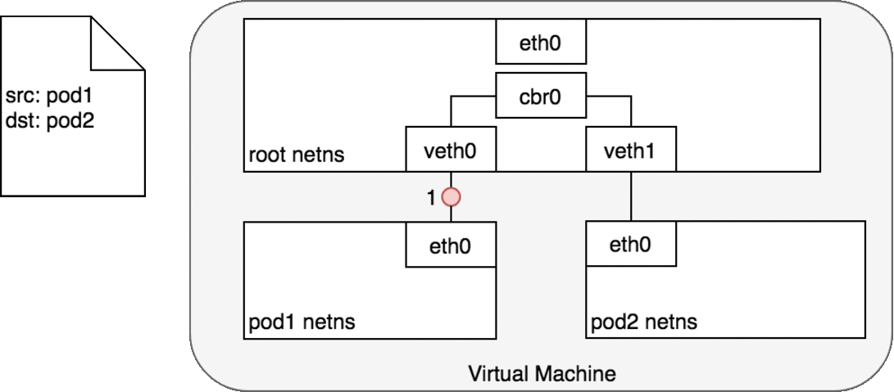
Pod to Pod networking
Container in same Pod: Using local host
Pod in same node: Using virtual network devices
www.viettel.com.vn
Notes:
Each Pod is assigned a unique IP address for each address family. Every container in a Pod shares the network namespace, including the IP address and network ports. Inside a Pod (and only then), the containers that belong to the Pod can communicate with one another using localhost. When containers in a Pod communicate with entities outside the Pod, they must coordinate how they use the shared network resources (such as ports). Within a Pod, containers share an IP address and port space, and can find each other via localhost. The containers in a Pod can also communicate with each other using standard inter-process communications like SystemV semaphores or POSIX shared memory. Containers in different Pods have distinct IP addresses and can not communicate by IPC without special configuration. Containers that want to interact with a container running in a different Pod can use IP networking to communicate.
Containers within the Pod see the system hostname as being the same as the configured name for the Pod. There's more about this in the networking section

Slide 44
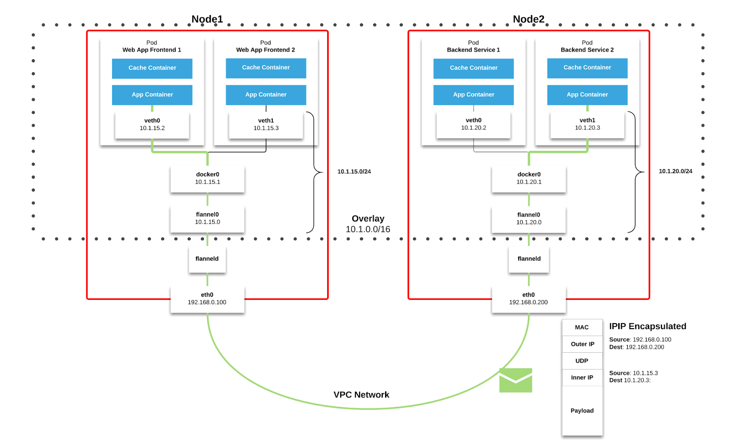
Pod to Pod networking
Pod in different node: Using CNI Network
www.viettel.com.vn
Notes:
Each Pod is assigned a unique IP address for each address family. Every container in a Pod shares the network namespace, including the IP address and network ports. Inside a Pod (and only then), the containers that belong to the Pod can communicate with one another using localhost. When containers in a Pod communicate with entities outside the Pod, they must coordinate how they use the shared network resources (such as ports). Within a Pod, containers share an IP address and port space, and can find each other via localhost. The containers in a Pod can also communicate with each other using standard inter-process communications like SystemV semaphores or POSIX shared memory. Containers in different Pods have distinct IP addresses and can not communicate by IPC without special configuration. Containers that want to interact with a container running in a different Pod can use IP networking to communicate.
Containers within the Pod see the system hostname as being the same as the configured name for the Pod. There's more about this in the networking section

Slide 45
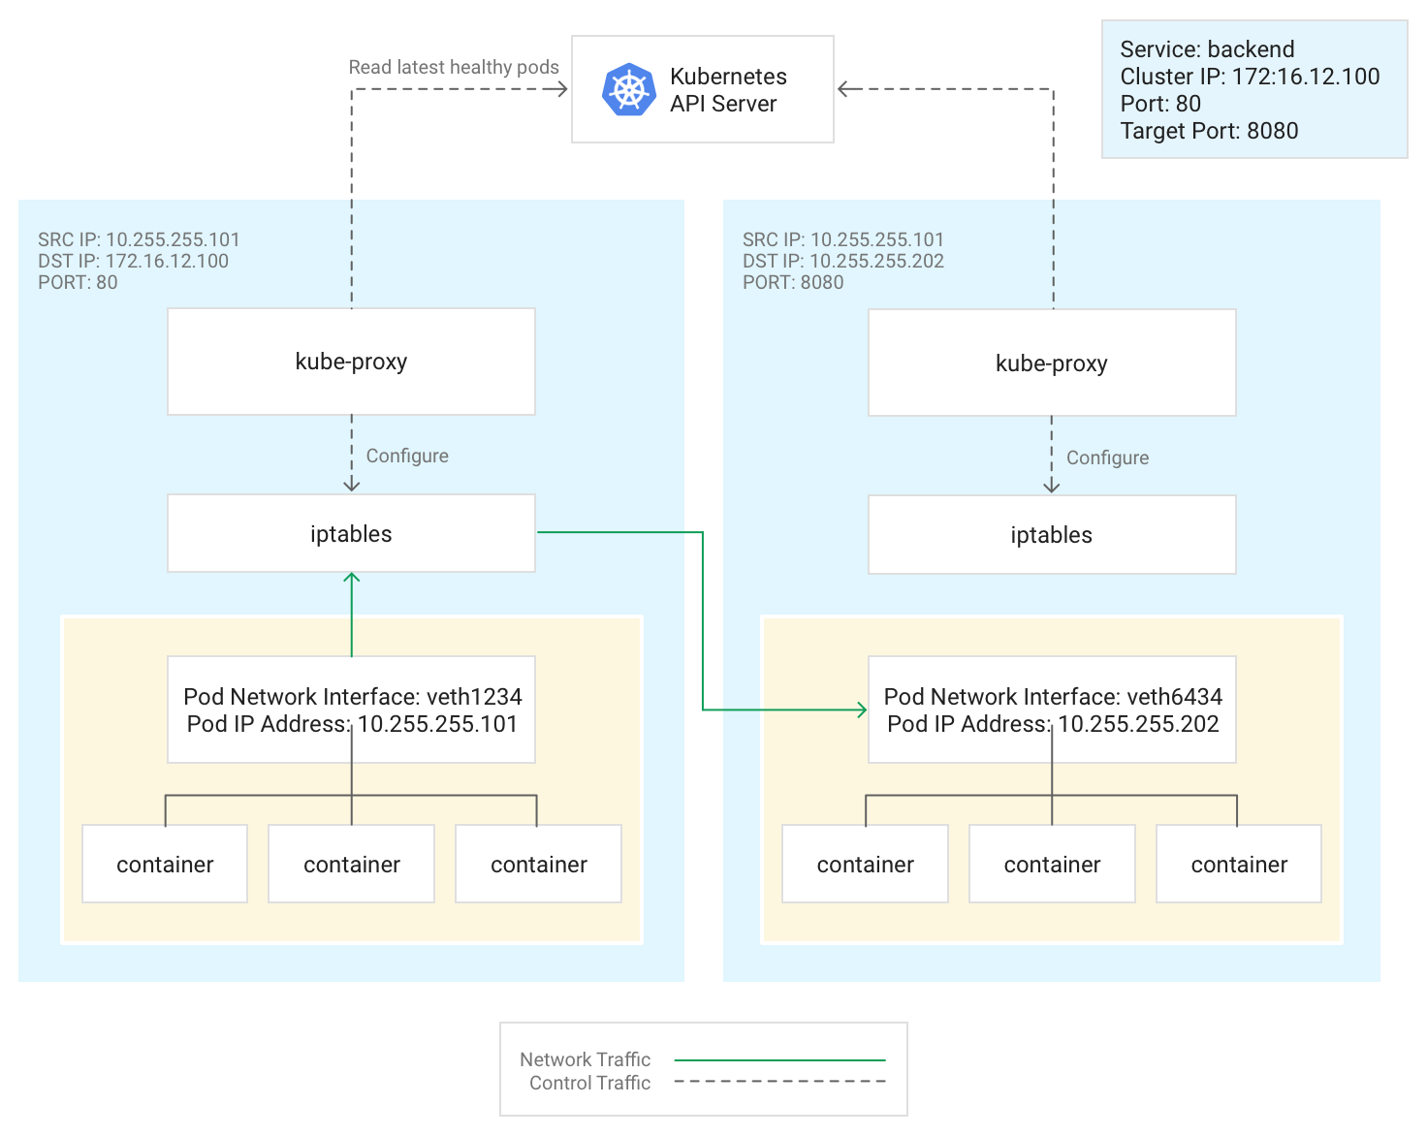
Pod to Service networking
Using iptables routes creates by kube-proxy
www.viettel.com.vn
Notes:
Each Pod is assigned a unique IP address for each address family. Every container in a Pod shares the network namespace, including the IP address and network ports. Inside a Pod (and only then), the containers that belong to the Pod can communicate with one another using localhost. When containers in a Pod communicate with entities outside the Pod, they must coordinate how they use the shared network resources (such as ports). Within a Pod, containers share an IP address and port space, and can find each other via localhost. The containers in a Pod can also communicate with each other using standard inter-process communications like SystemV semaphores or POSIX shared memory. Containers in different Pods have distinct IP addresses and can not communicate by IPC without special configuration. Containers that want to interact with a container running in a different Pod can use IP networking to communicate.
Containers within the Pod see the system hostname as being the same as the configured name for the Pod. There's more about this in the networking section

Slide 46
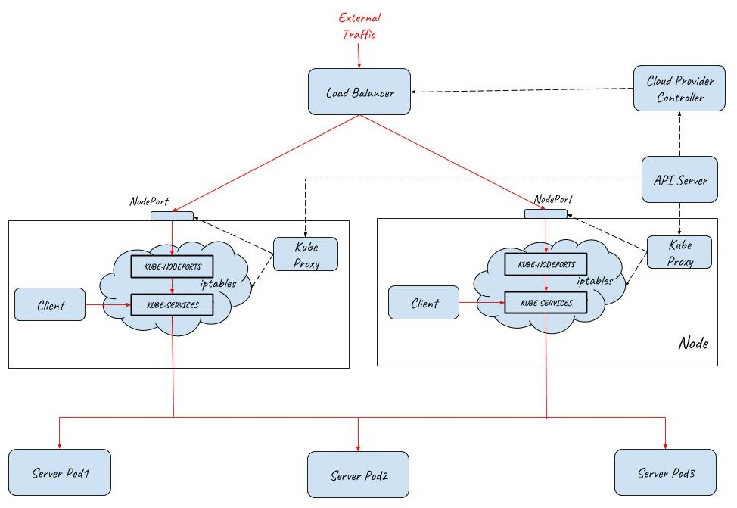
External user to Pod traffic
Using iptables routes creates by kube-proxy
www.viettel.com.vn
Notes:
Each Pod is assigned a unique IP address for each address family. Every container in a Pod shares the network namespace, including the IP address and network ports. Inside a Pod (and only then), the containers that belong to the Pod can communicate with one another using localhost. When containers in a Pod communicate with entities outside the Pod, they must coordinate how they use the shared network resources (such as ports). Within a Pod, containers share an IP address and port space, and can find each other via localhost. The containers in a Pod can also communicate with each other using standard inter-process communications like SystemV semaphores or POSIX shared memory. Containers in different Pods have distinct IP addresses and can not communicate by IPC without special configuration. Containers that want to interact with a container running in a different Pod can use IP networking to communicate.
Containers within the Pod see the system hostname as being the same as the configured name for the Pod. There's more about this in the networking section

Slide 47
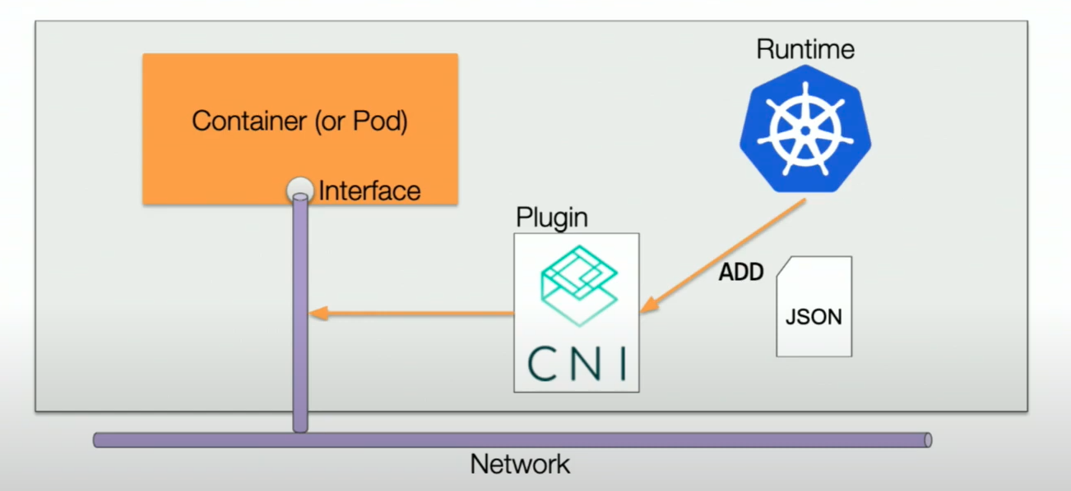
K8S network plugin - CNI Plugin
www.viettel.com.vn
Notes:
- Inserting network interface into network namespaces
- Assign Ip Address by using IPAM plugin

Slide 48
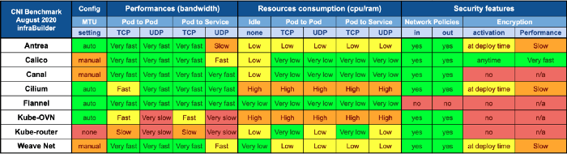
K8S network plugin - CNI Plugin
www.viettel.com.vn
Notes:
- Inserting network interface into network namespaces
- Assign Ip Address by using IPAM plugin

Slide 49
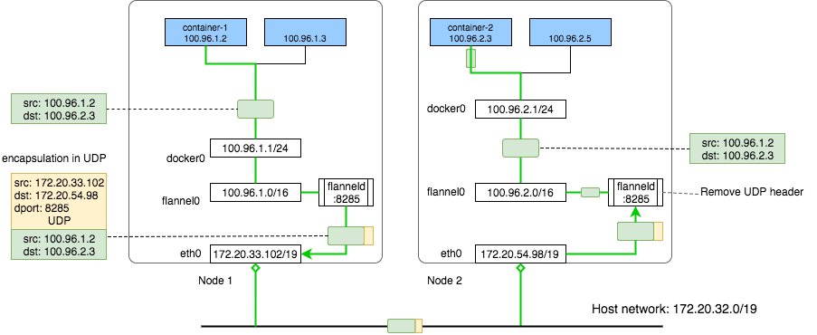
Flannel Network Plugin
Simple, easy to install
Work for most environment with VXLAN modes
www.viettel.com.vn
Notes:
Each Pod is assigned a unique IP address for each address family. Every container in a Pod shares the network namespace, including the IP address and network ports. Inside a Pod (and only then), the containers that belong to the Pod can communicate with one another using localhost. When containers in a Pod communicate with entities outside the Pod, they must coordinate how they use the shared network resources (such as ports). Within a Pod, containers share an IP address and port space, and can find each other via localhost. The containers in a Pod can also communicate with each other using standard inter-process communications like SystemV semaphores or POSIX shared memory. Containers in different Pods have distinct IP addresses and can not communicate by IPC without special configuration. Containers that want to interact with a container running in a different Pod can use IP networking to communicate.
Containers within the Pod see the system hostname as being the same as the configured name for the Pod. There's more about this in the networking section

Slide 50
Persistent Storage
www.viettel.com.vn

Slide 51

Persistent Storage
Use case: Stateful applications
www.viettel.com.vn
Notes:
Each Pod is assigned a unique IP address for each address family. Every container in a Pod shares the network namespace, including the IP address and network ports. Inside a Pod (and only then), the containers that belong to the Pod can communicate with one another using localhost. When containers in a Pod communicate with entities outside the Pod, they must coordinate how they use the shared network resources (such as ports). Within a Pod, containers share an IP address and port space, and can find each other via localhost. The containers in a Pod can also communicate with each other using standard inter-process communications like SystemV semaphores or POSIX shared memory. Containers in different Pods have distinct IP addresses and can not communicate by IPC without special configuration. Containers that want to interact with a container running in a different Pod can use IP networking to communicate.
Containers within the Pod see the system hostname as being the same as the configured name for the Pod. There's more about this in the networking section

Slide 52

K8S Storage Resources
Persistent Volume
Persistent Volume Claim
StorageClass
www.viettel.com.vn
Notes:
Each Pod is assigned a unique IP address for each address family. Every container in a Pod shares the network namespace, including the IP address and network ports. Inside a Pod (and only then), the containers that belong to the Pod can communicate with one another using localhost. When containers in a Pod communicate with entities outside the Pod, they must coordinate how they use the shared network resources (such as ports). Within a Pod, containers share an IP address and port space, and can find each other via localhost. The containers in a Pod can also communicate with each other using standard inter-process communications like SystemV semaphores or POSIX shared memory. Containers in different Pods have distinct IP addresses and can not communicate by IPC without special configuration. Containers that want to interact with a container running in a different Pod can use IP networking to communicate.
Containers within the Pod see the system hostname as being the same as the configured name for the Pod. There's more about this in the networking section

Slide 53
Service Mesh
www.viettel.com.vn

Slide 54

Monolith to Microservices
www.viettel.com.vn
Notes:
- Lợi ích thì nhiều
+ Isolation
+ Scability
+ Flexibility
+
Thách thức
- Service discovery
- Fault tolerance
- Security
- Load Balancing
- Distributed Tracing
- Rate Limiting

Slide 55

Network Functions
www.viettel.com.vn

Slide 56

Service mesh
www.viettel.com.vn
Notes:
Service Mesh là một inter-service communication infrastructure layer (một tầng liên quan tới network, proxy, hỗ trợ giao tiếp giữa các services) nó được integrate trực tiếp vô hệ thống services của một application, thông qua đó mình sẽ điều khiển được luồng xử lý,

Slide 57

Service mesh
www.viettel.com.vn
Notes:
Service Mesh là một inter-service communication infrastructure layer (một tầng liên quan tới network, proxy, hỗ trợ giao tiếp giữa các services) nó được integrate trực tiếp vô hệ thống services của một application, thông qua đó mình sẽ điều khiển được luồng xử lý,

Slide 58

THANK YOU
www.viettel.com.vn

